Slide 1
Sports Data Science
dr. Arno Knobbe, Universiteit Leiden

Slide 2



About my Background
Computer Scientist turned Data Scientist turned Sports Data Scientist
Research group in Sports Data Science
Director of Sport Data Center
  Dutch consortium of universities with Sports or Data Science interests
  National sports data platform Sport Data Valley

Slide 3

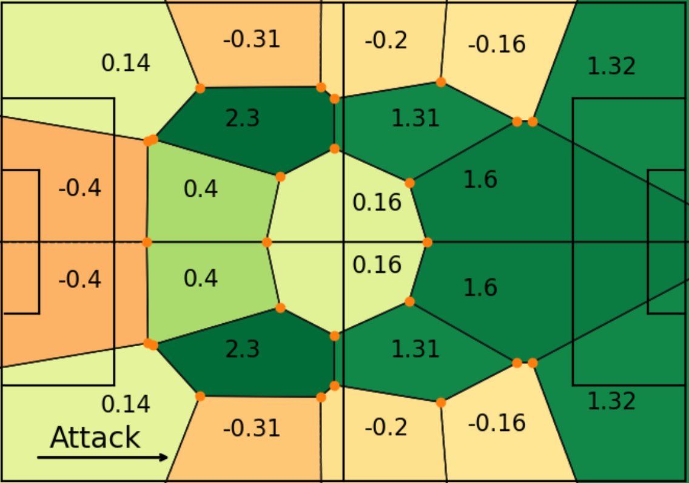
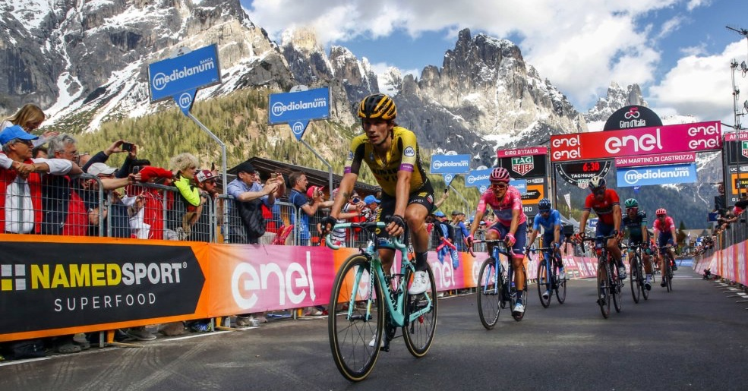
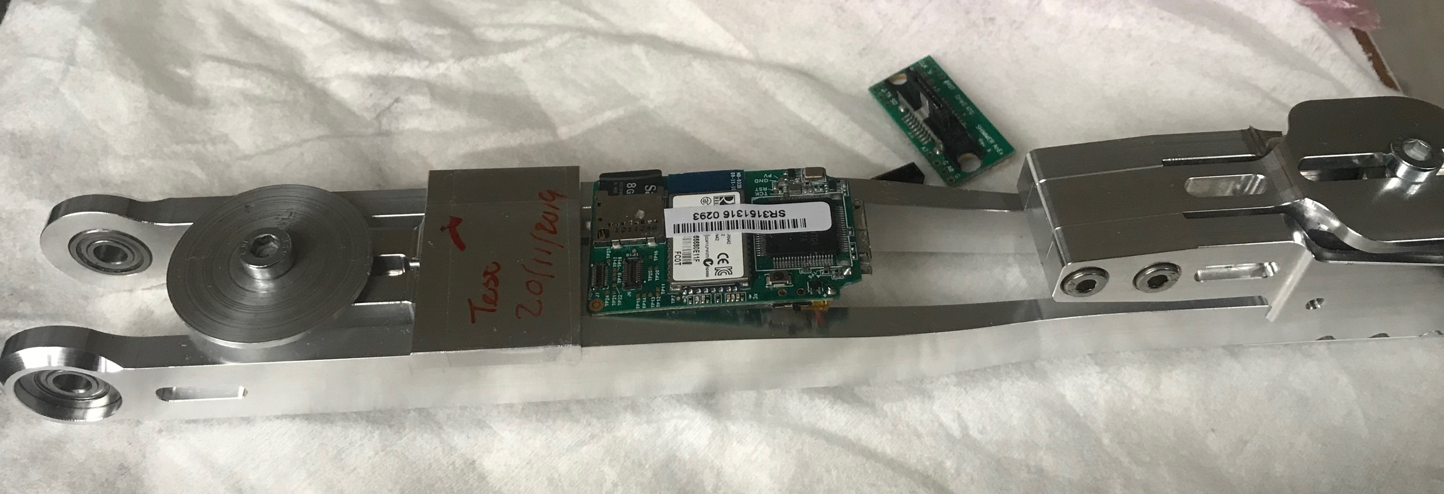
Sports Disciplines
Football
volleyball
skiing
tennis
archery
…
Cycling
Speed Skating

Slide 4
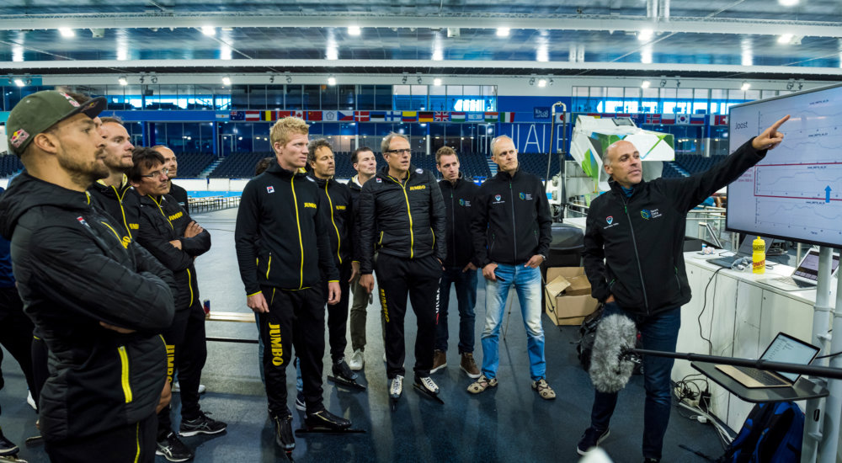
Our Approach
Practical Performance Analysis
  Elite sports
  Data-intensive, but small N
  Personalised
  Input on training schedule, injury risk, technique, pacing, race tactics, …
Physiological modelling
  Training data
  Wearables, sensors
  Incorporate physiological theory

Slide 5

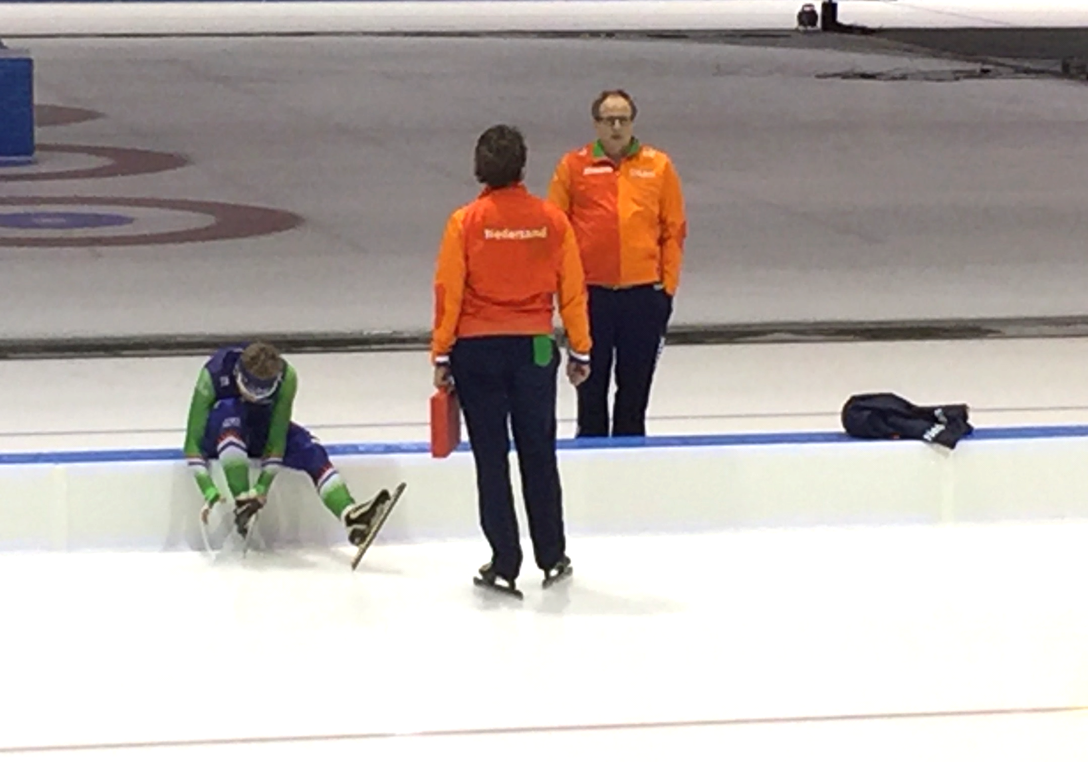
Speed Skating with
Team Jumbo Visma
Sports analytics for professional speed skating,
Knobbe et al., Data Mining and Knowledge Discovery 31 (6), 2017

Slide 6
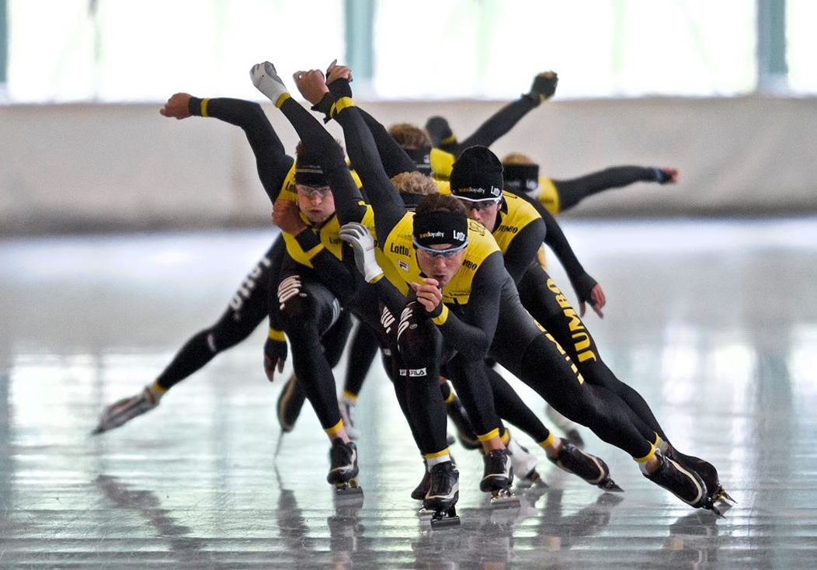
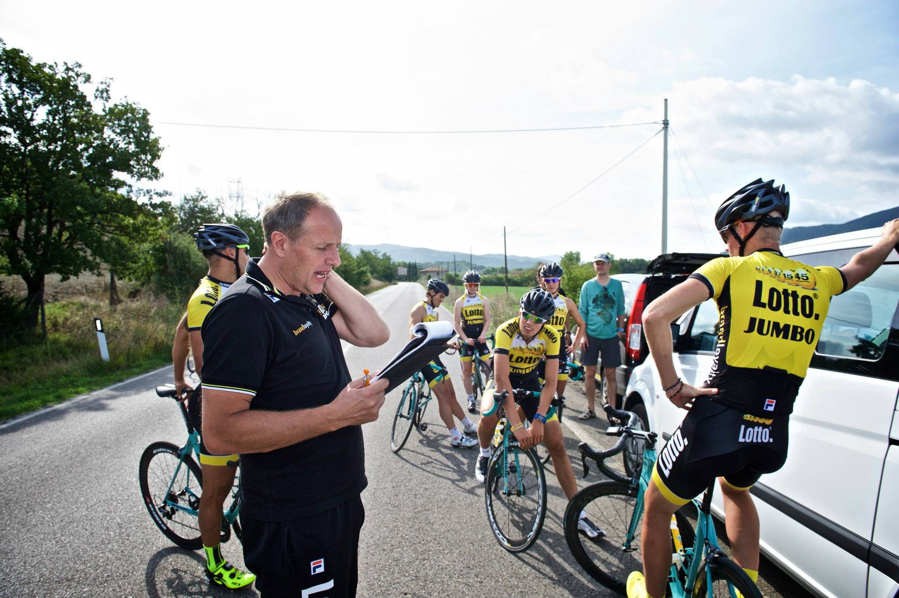
Team Jumbo-Visma Speed Skating
Skaters: Sven Kramer, Kjeld Nuis, …
Some 30+ Olympic medals
+ numerous championships

Slide 7

Research Aims
Service Jumbo-Visma with insights
Act as research partner
What factors in the training routines affect performance?
  load, periodization, sickness, atmospheric conditions
  detailed optimization, tweaking
Personalised training advice
  Male vs. female
  Discipline-specific
  Athlete-specific

Slide 8

Historical Training Data
20 years of data collected
Some 40 athletes
Daily training details
  Morning and afternoon training
  Six days per week
  Training type, intensity (subjective), duration, load
Roughly bi-monthly physical test
  Aerobic
  Anaerobic
Competition data
  Corrected for track-differences

Slide 9
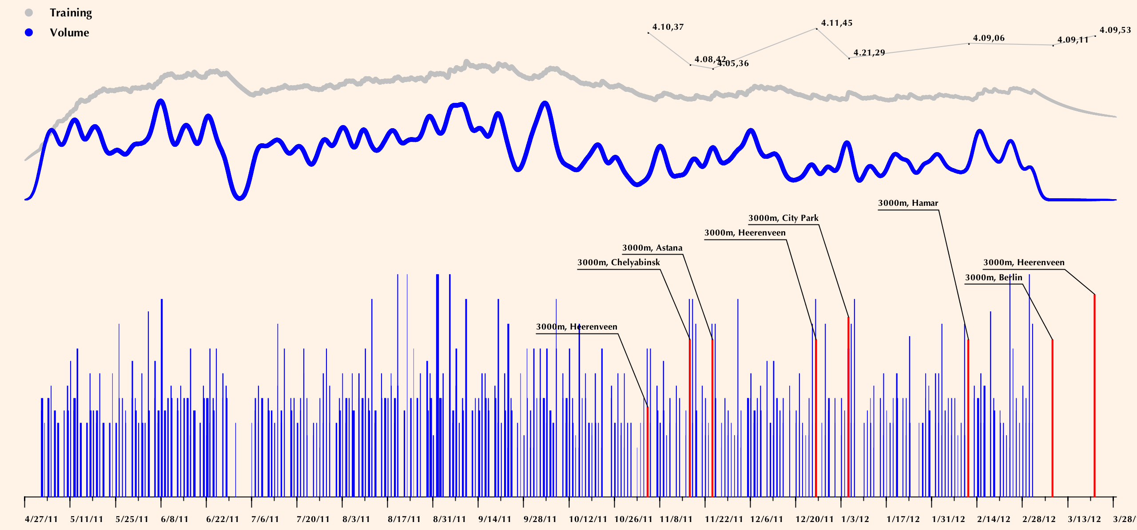
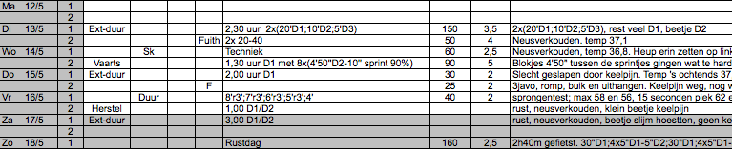
Speed Skating Data
intensity
duration
Kjeld Nuis 1000 m

Slide 10
Personalised Advice
Elite sports require perfection
Training schedules adapted to personal needs
difference between disciplines (sprint, endurance, …) not sufficient
Subtle personal differences in physiology
  personal differences in training parameters
Data-driven approach to optimise training

Slide 11
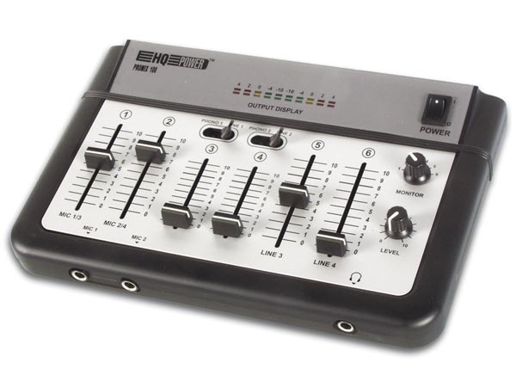
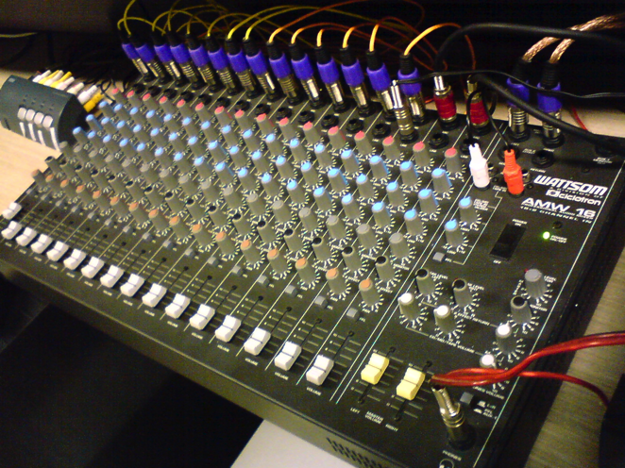
Fine Tuning
> 200 variables (mostly derived)
which knobs are not at their optimal setting?
1 to 2% gain

Slide 12

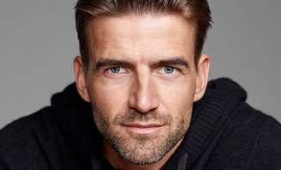
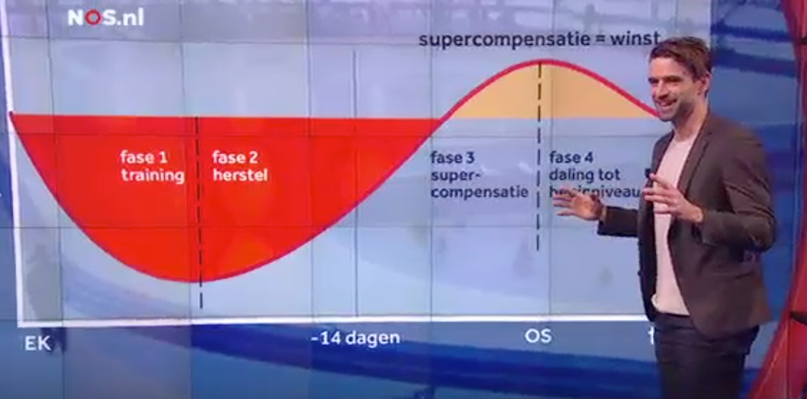
Mark Tuitert
Former skater
Olympic gold on 1500 m in 2010 (Vancouver)
Sports commentator at NOS and personal coach
Training distribution in 1500-m speed skating:
a case study of an Olympic gold medalist
Orie et al., International journal of sports physiology and performance 16 (1), 2020

Slide 13
Mark Tuitert
intensity

Slide 14
Mark Tuitert
Wingate test: where do I stand?
Good indicator for 1500 m result

Slide 15
Mark Tuitert

Slide 16
Mark Tuitert

Slide 17
A Single Training Session
According to the Fitness-Fatigue model
  initial fatigue
  after minor delay, supercompensation
  gradual decay to rest fitness

Slide 18
The Effect of Training
test
moment
tapering
windows

Slide 19
Aspects of Periodization
Within each window:
count How many exercises?
sum (duration, load) How many minutes, …?
max (duration, intensity, load) Did you recently …?
stddev (duration, intensity, load) How varying was …?
Determiners
of specific activities
just in the morning/afternoon
certain intensity ranges (zones)
Sum of duration over 14-day period
Max of intensity over 2-day period
Sum of duration over 21-day period, morning sessions
Sum of duration over 21-day period, intensities 6, …, 9
Maximum of load over 7-day period, cycling
…

Slide 20
Modelling Training/Response
Each variable will have a U-shape
Neither too little, nor too much
In theory non-linear, in practice only a sample
  linear model
  threshold model
relative time
optimum
training load
available
data

Slide 21
Modeling Techniques
Feature extraction (aggregation)
  from sequence data to classical tabular data
  physiological model-based (FF-model)
  or, brute force
Linear modeling (univariate)
Subgroup Discovery
  regression setting (R² quality measure)
  find combinations of features that influence performance
Lasso regression (multivariate)
  prediction (not so relevant)

Slide 22
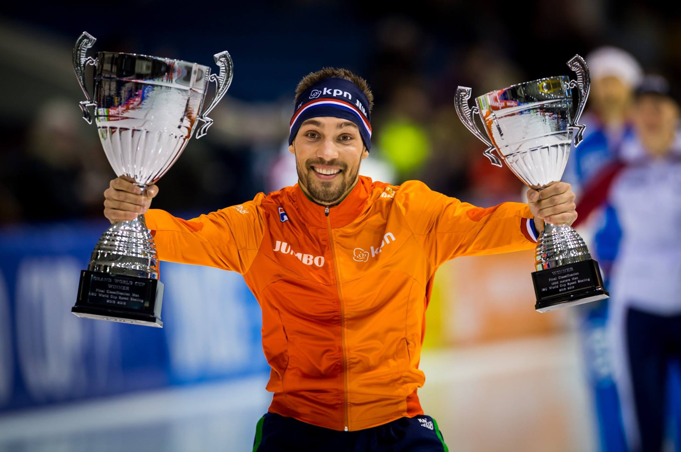
Kjeld Nuis
178 races
On average 2.89% above track record
Specialises on 1000 m (2.1%)
2015-2016
  Dutch champion 1000 m, 1500 m
  WC Distances: bronze 1000 m, silver 1500 m
  WC Sprint: ‘silver’
  ISU World Cup: gold 1000 m, silver 1500 m

Slide 23
Total sum of load over last 5 days, morning sessions
undesired result
due to over-training
advised upper
limit

Slide 24
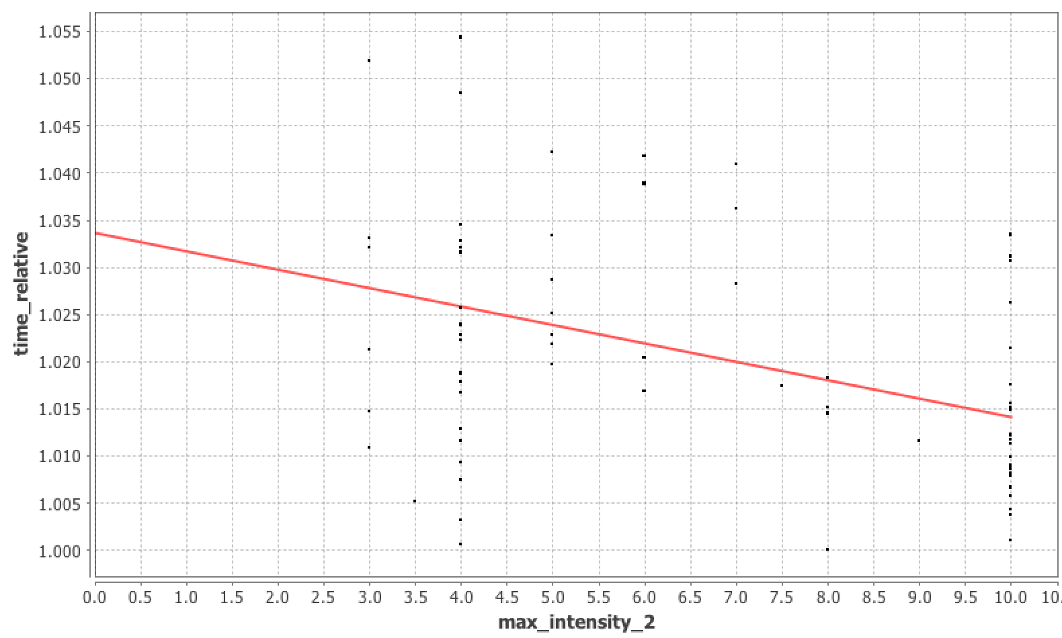
Maximum intensity 8 or higher in the two days prior to the race
advised lower
limit

Slide 25
The Fitness/Fatigue model
Fitness effect of training:
Fatigue effect of training:

Slide 26
Individual Physiological Parameters
τ_{fit}: how long does the training effect last?
τ_{fat}: how long are you tired after a training?
K: how disturbing is fatigue relative to the benefits of training?

Slide 27
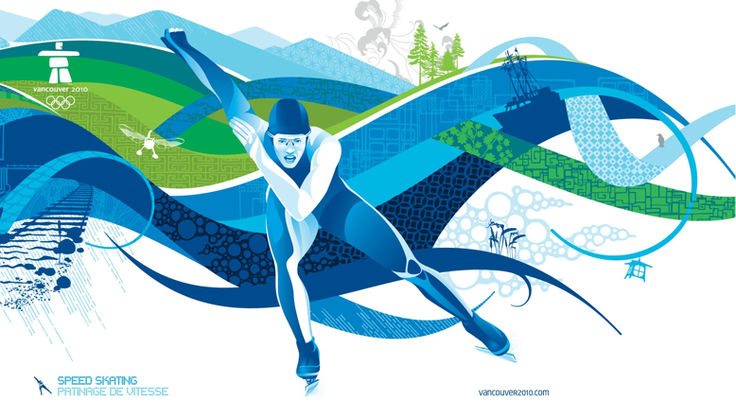
Conclusions
Longitudinal detailed data has lots of potential
Practical advise to coach
Personalised advice
  possibly conflicting advice between athletes
Window-based features currently outperform physiological model

Slide 28
Questions?

