Slide 1


Providing Personalised Training Insights in Cycling for
Team Jumbo Visma
Arno Knobbe, Universiteit Leiden

Slide 2
Exploiting sensor data in professional road cycling: Personalized data-driven approach for frequent fitness monitoring,
de Leeuw et al., Data Mining and Knowledge Discovery 37 (3), 2023
Maximal test
  infrequent (handful per season), snapshot
  disturbing
Towards daily fitness assessment in the field

Slide 3
Heart Rate and Exertion
fatigue
exercise
oxygen debt
altitude
stress
…
heart rate

Slide 4
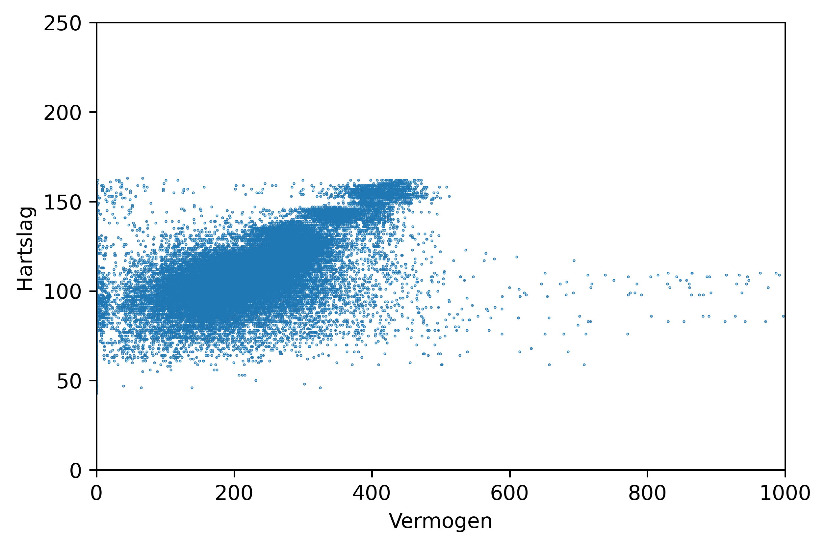
Heart Rate and Pedal Power
momentary power spikes
heart rate hardly affected

Slide 5
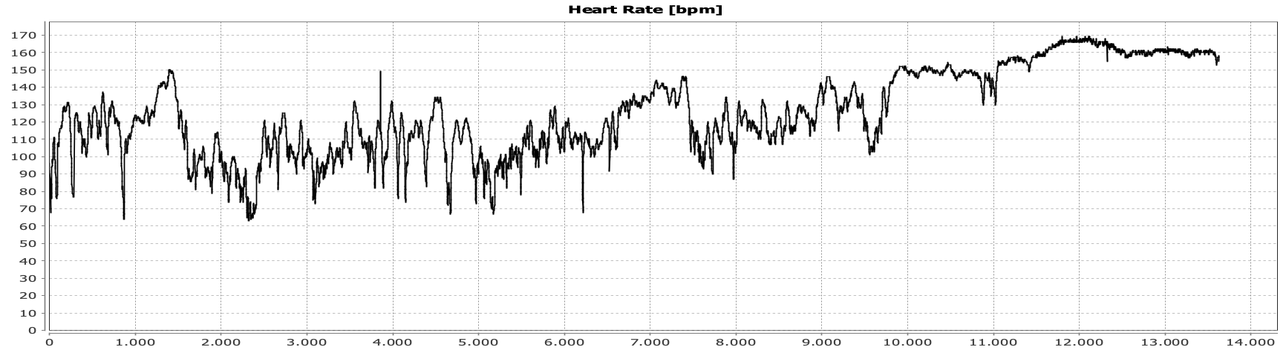
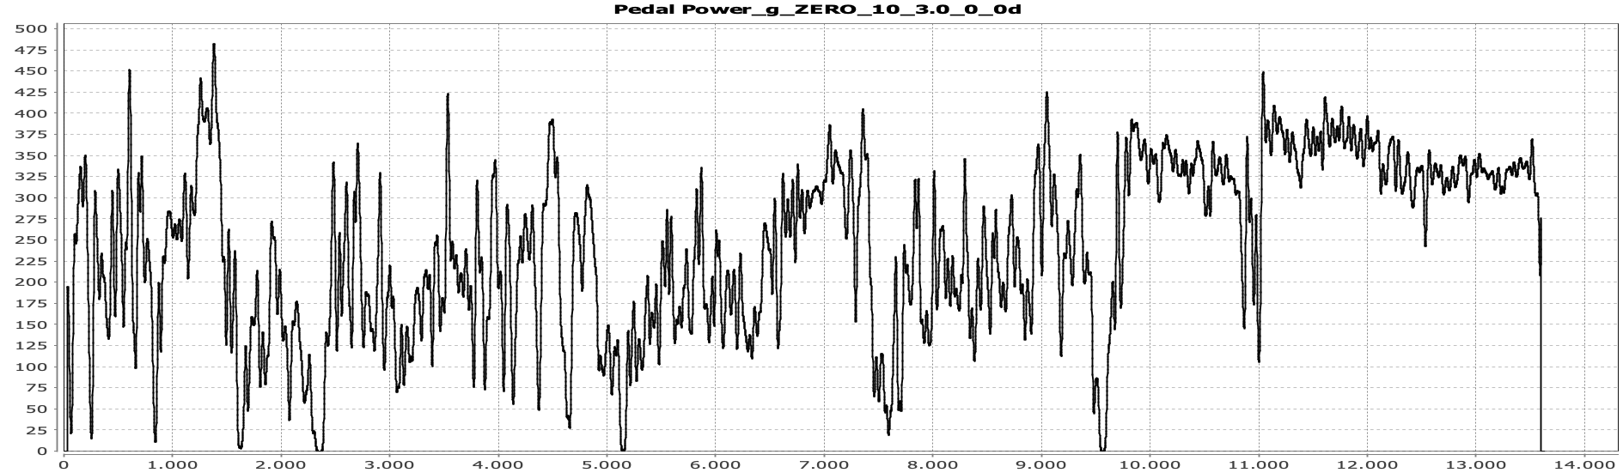
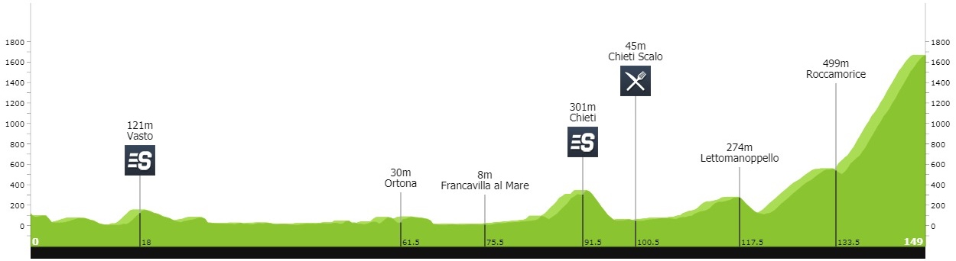
Heart Rate and Pedal Power
225 minutes (3:45)
Giro d’Italia 2017, stage 9: Montenero di Bisaccia › Blockhaus
pedal power convoluted with Gaussian 𝜎 = 10 s
Notes:
Source image stage 9: https://www.procyclingstats.com/race/giro-d-italia/2017/stage-9

Slide 6
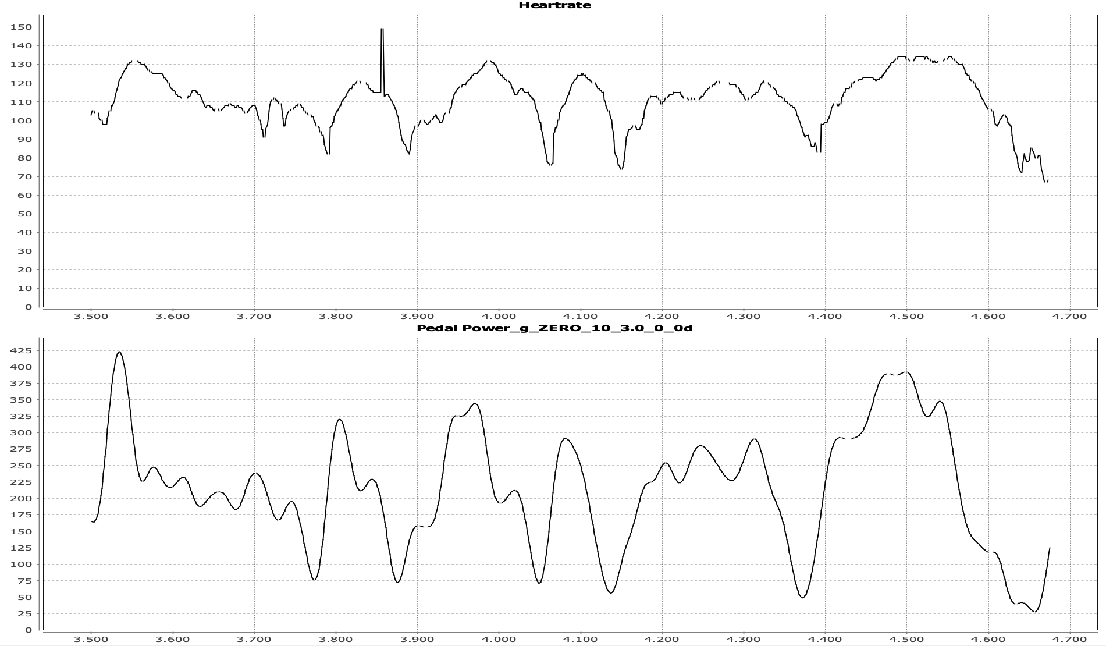
Heart Rate and Pedal Power smoothed with Gaussian
20 minutes detail

Slide 7
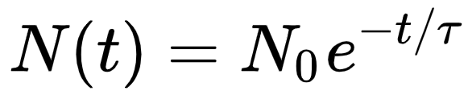
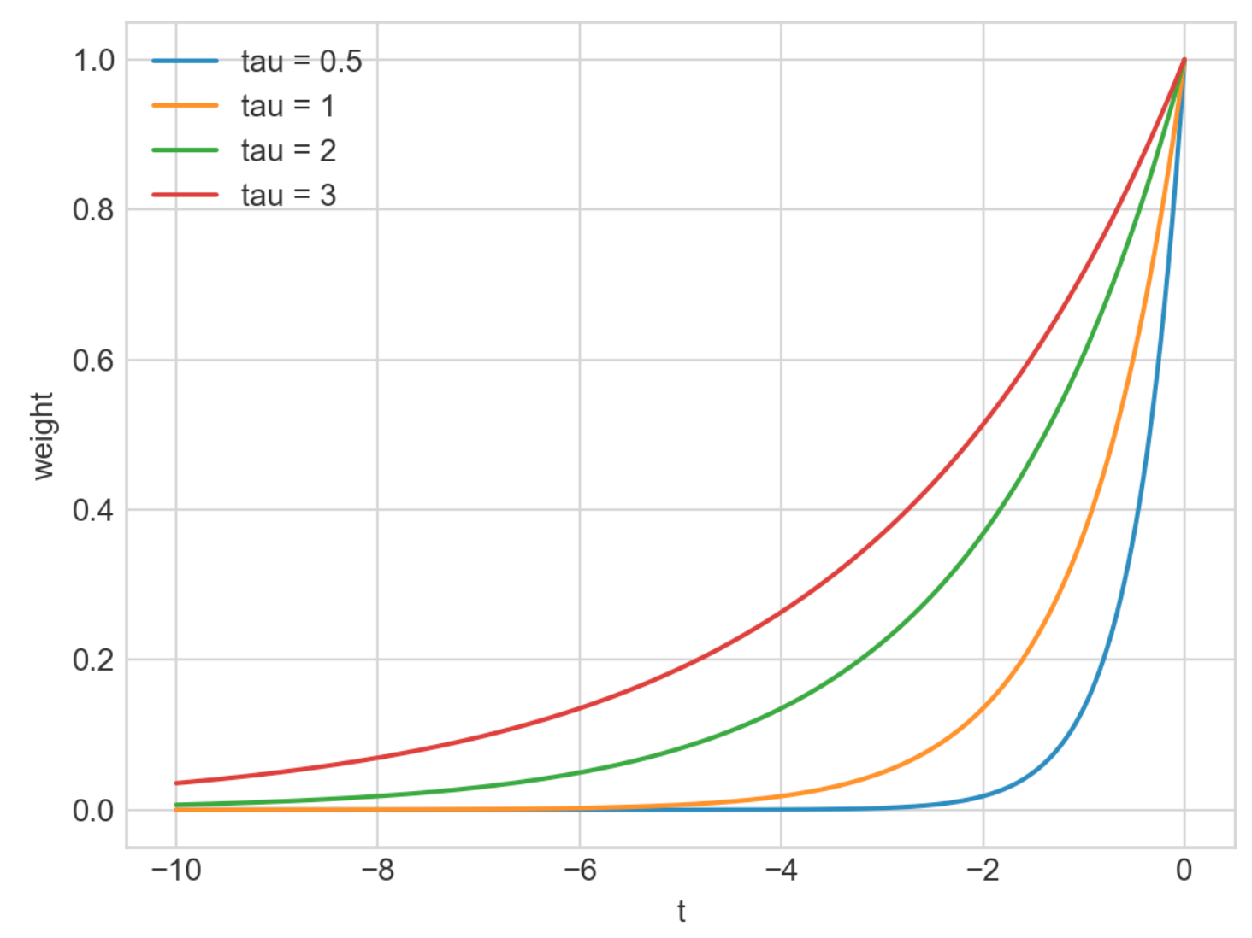
Exponential Decay
Rationale: the influence of past events deminishes exponentially
Exponential time constant tau is mean life time (= lag)
  athlete-specific
  τ = 30…50 s
Notes:
Source: https://en.wikipedia.org/wiki/Exponential_decay
ln(2) = 0.693

Slide 8
Heart Rate and Pedal Power smoothed with Gaussian

Slide 9
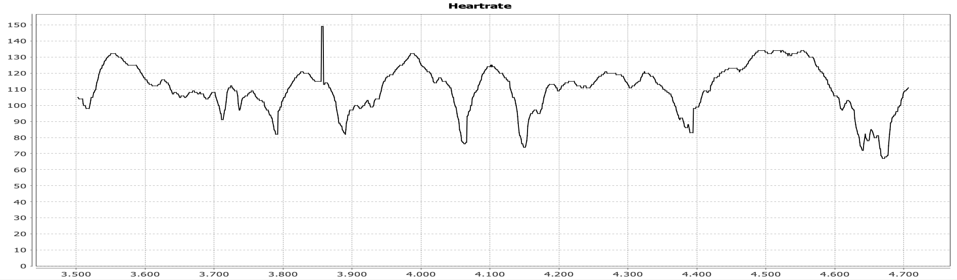
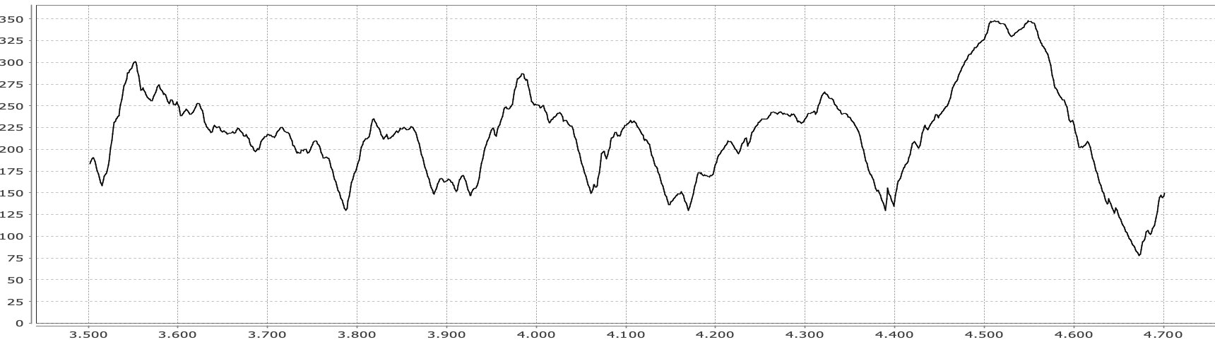
Heart Rate and Pedal Power convolution with exponential kernel
τ = 37 s

Slide 10
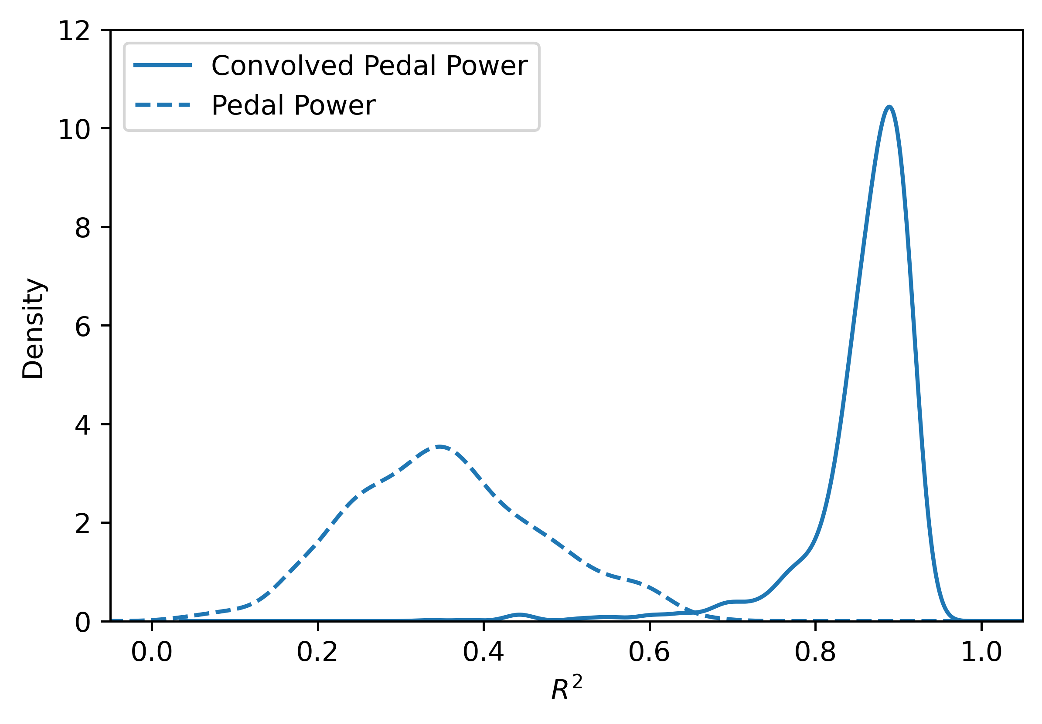
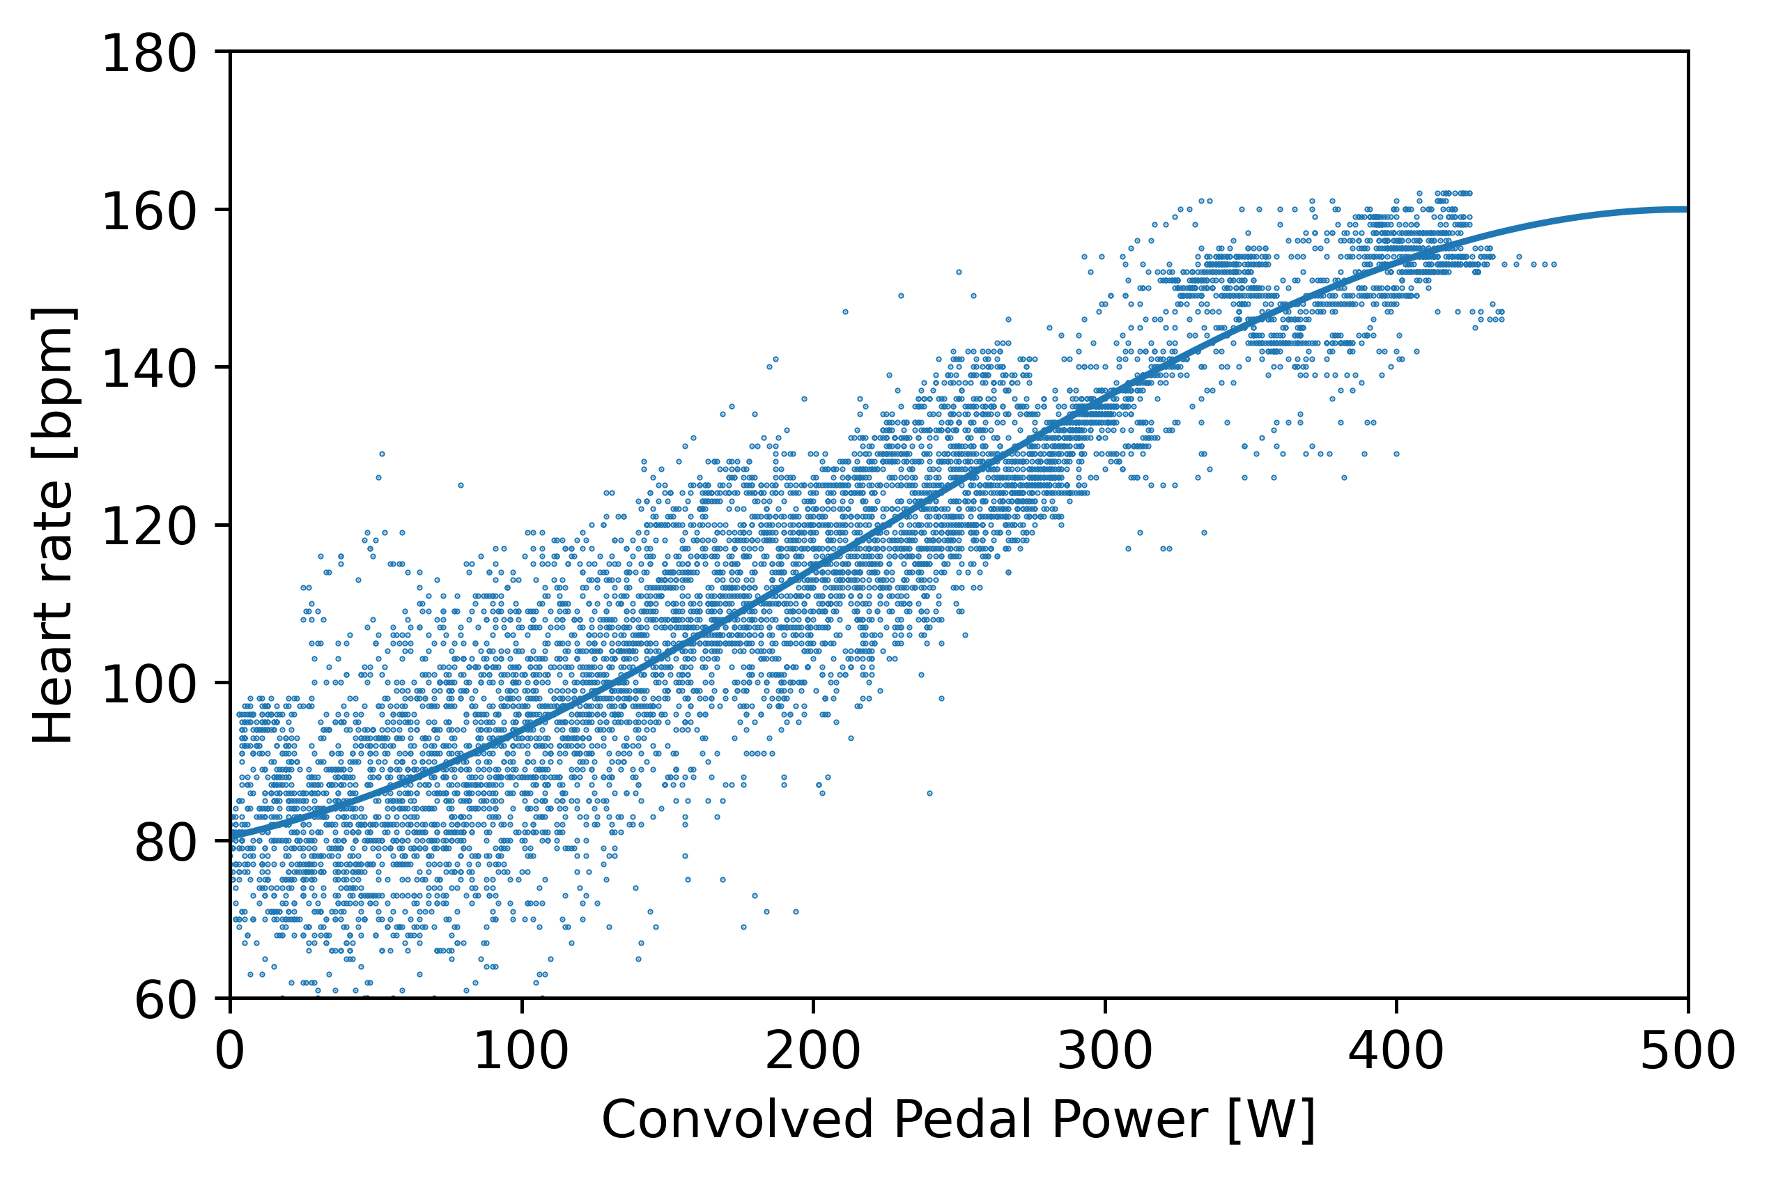
Heart Rate and Pedal Power

Slide 11
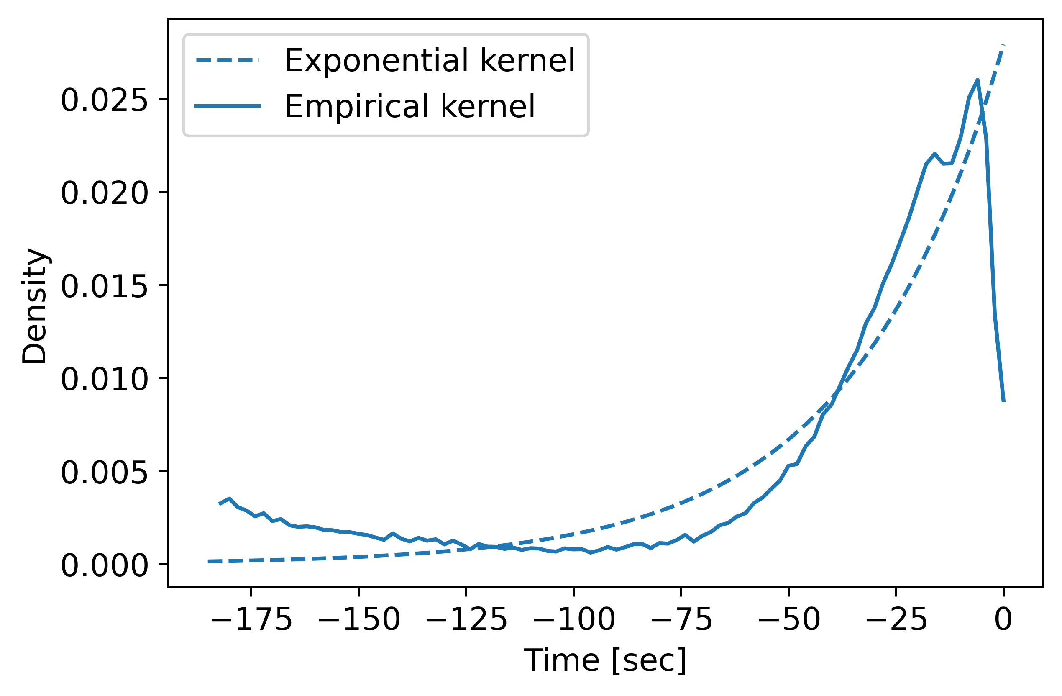
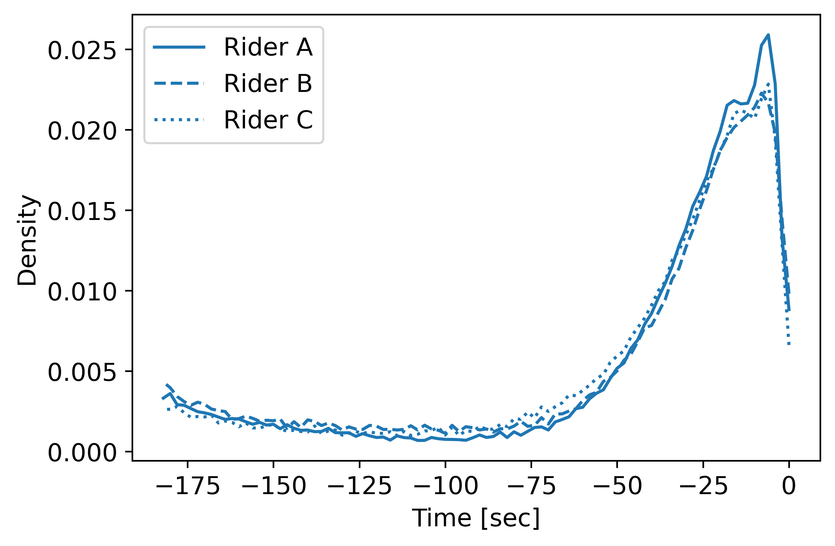
Exponential, really?

Slide 12
Convolved Power
R² = 0.836
Adding contextual information (ride duration, altitude, …)
R² = 0.854

Slide 13
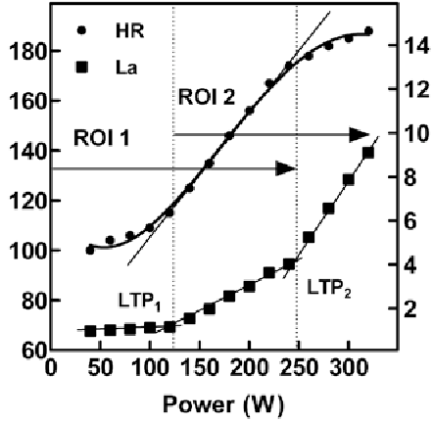
Convolved Power
R² = 0.836
P. Hofmann and R. Pokan, IJSPP, 2010

Slide 14
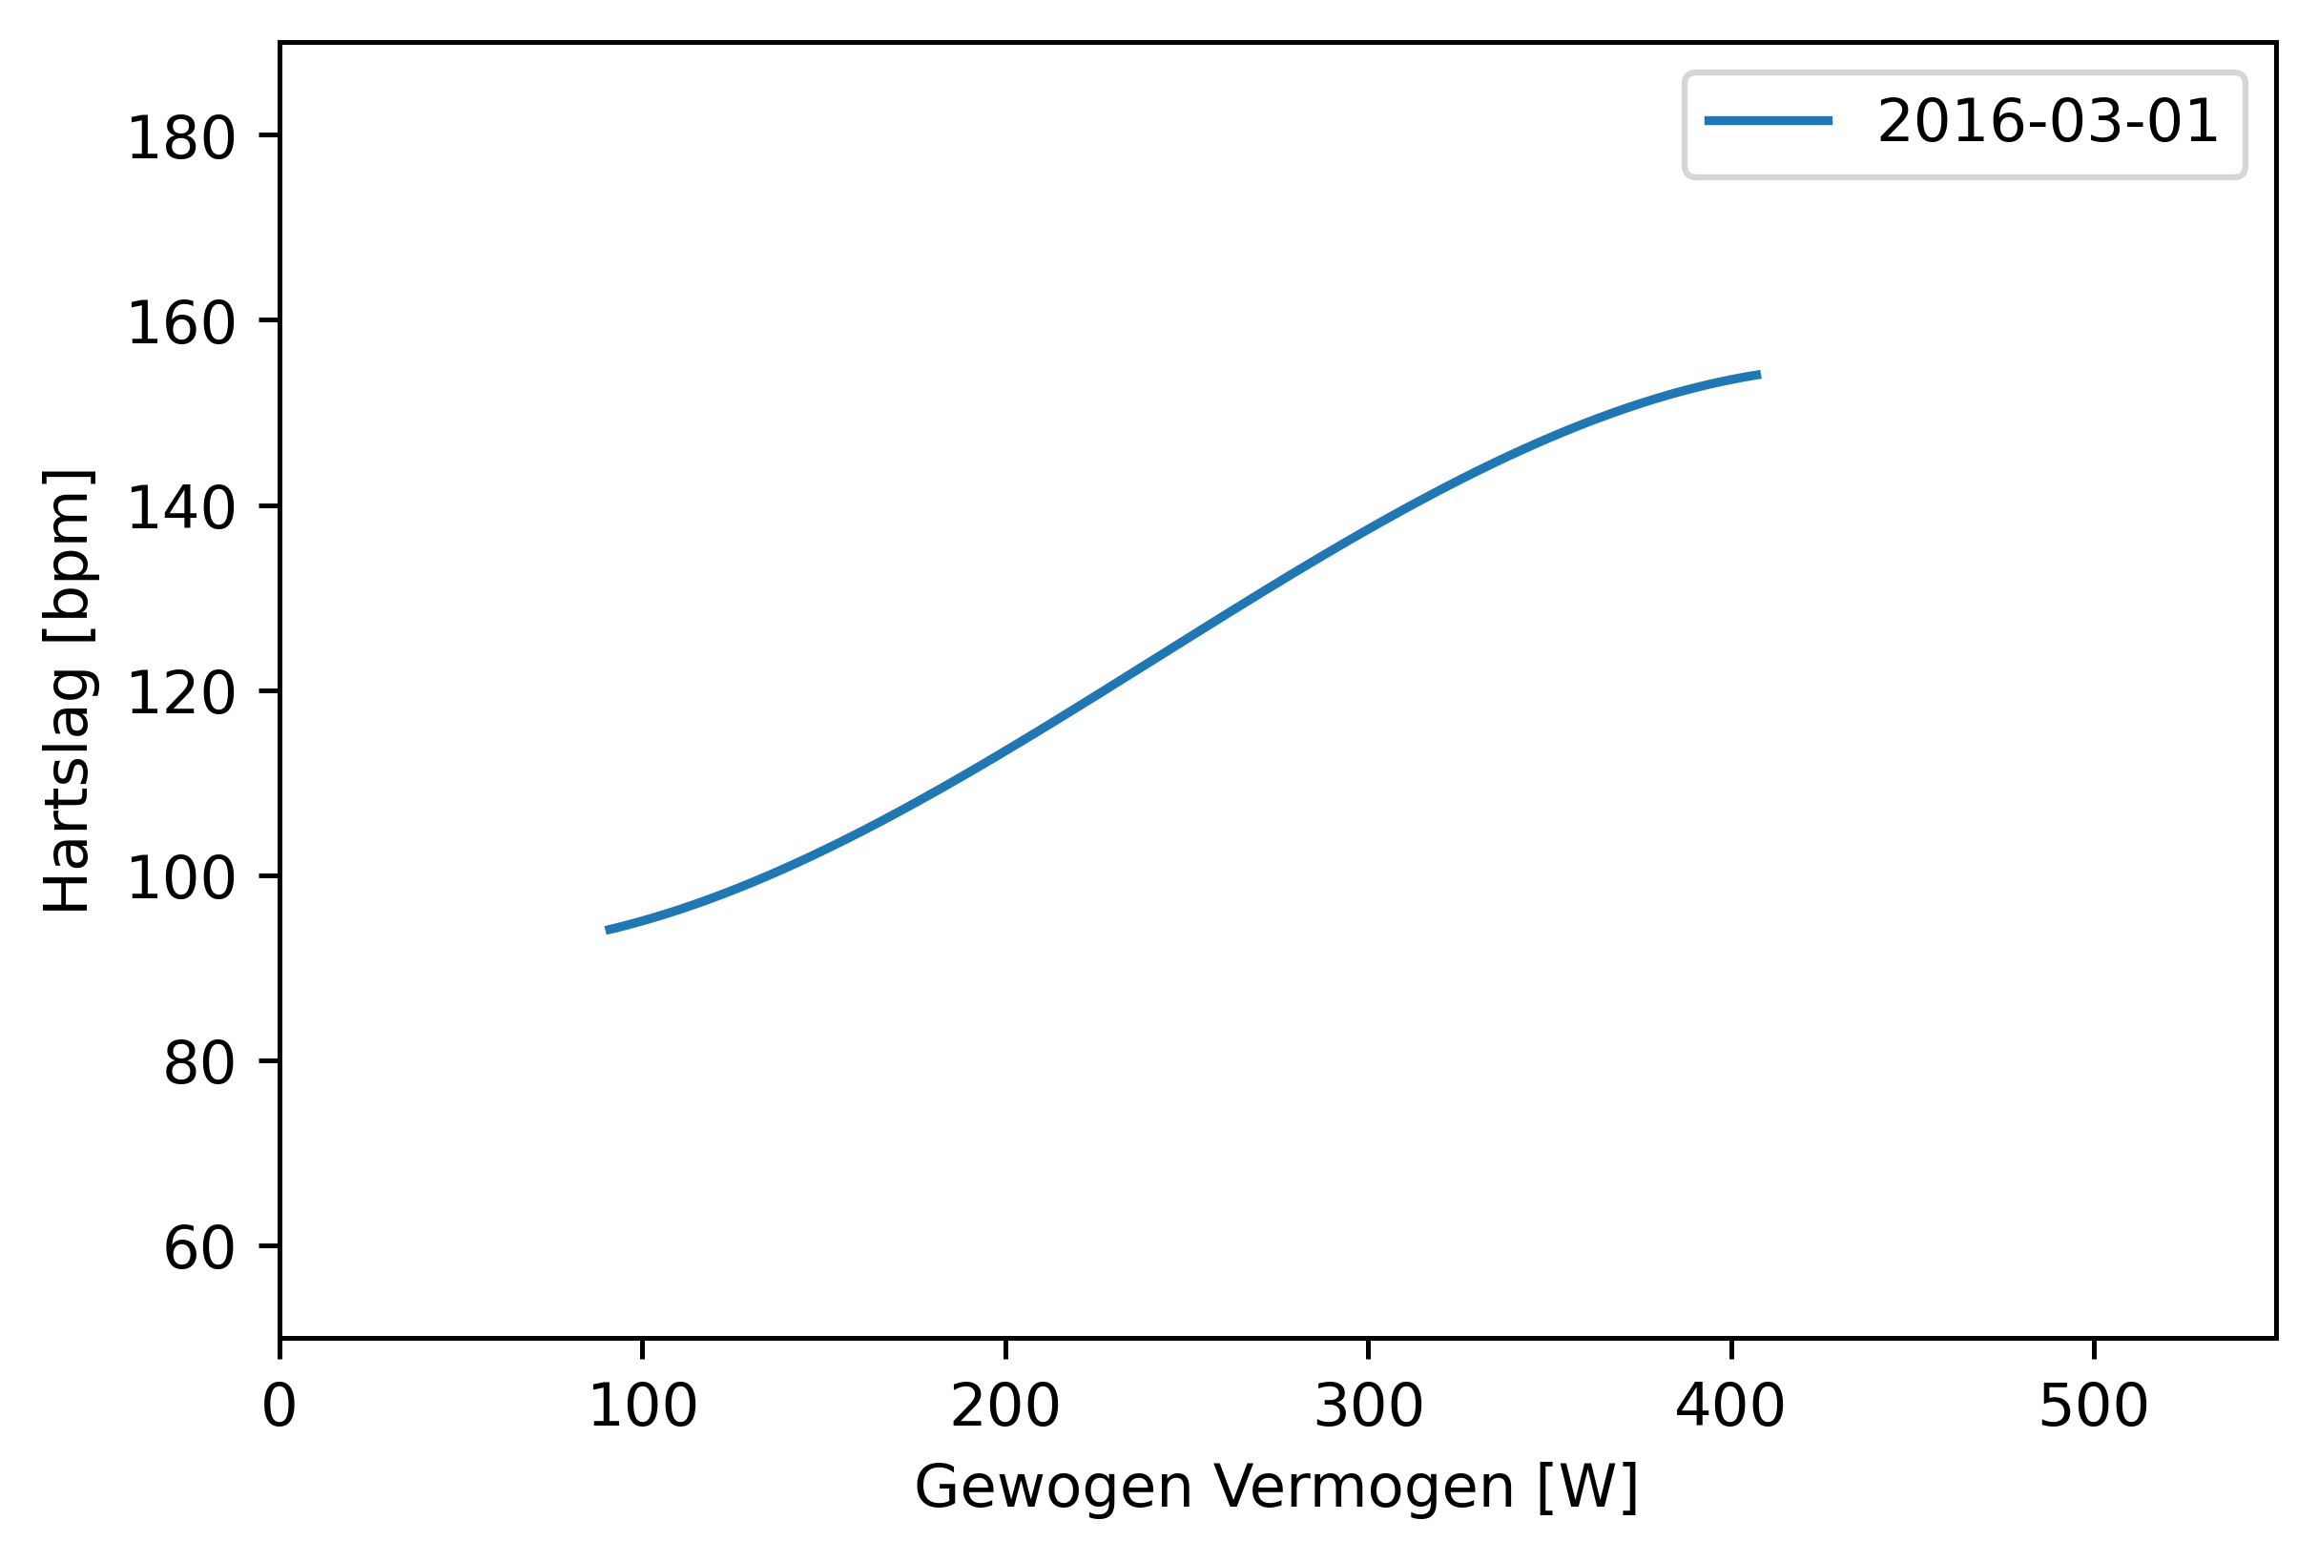
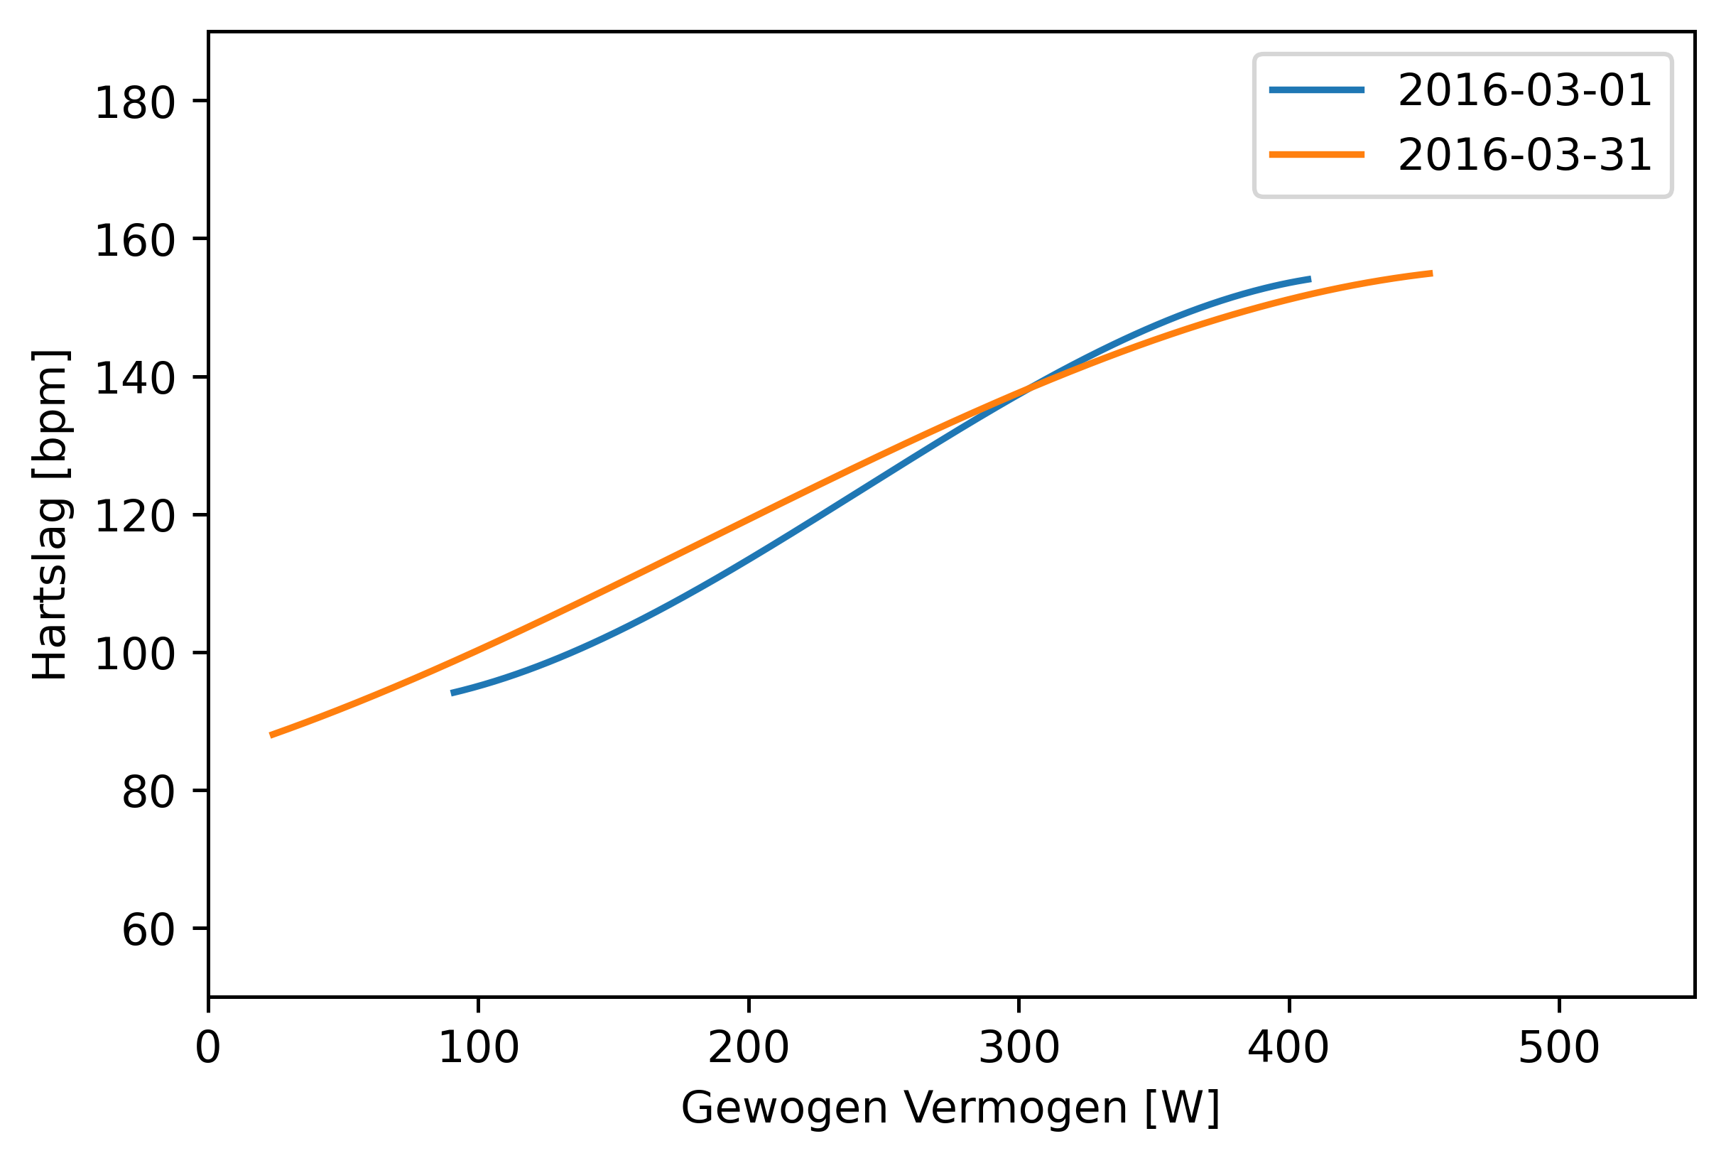
Heart Rate Performance Curve
Heart rate performance curves can be determined per day
1 March 2016 vs. 31 March 2016

Slide 15
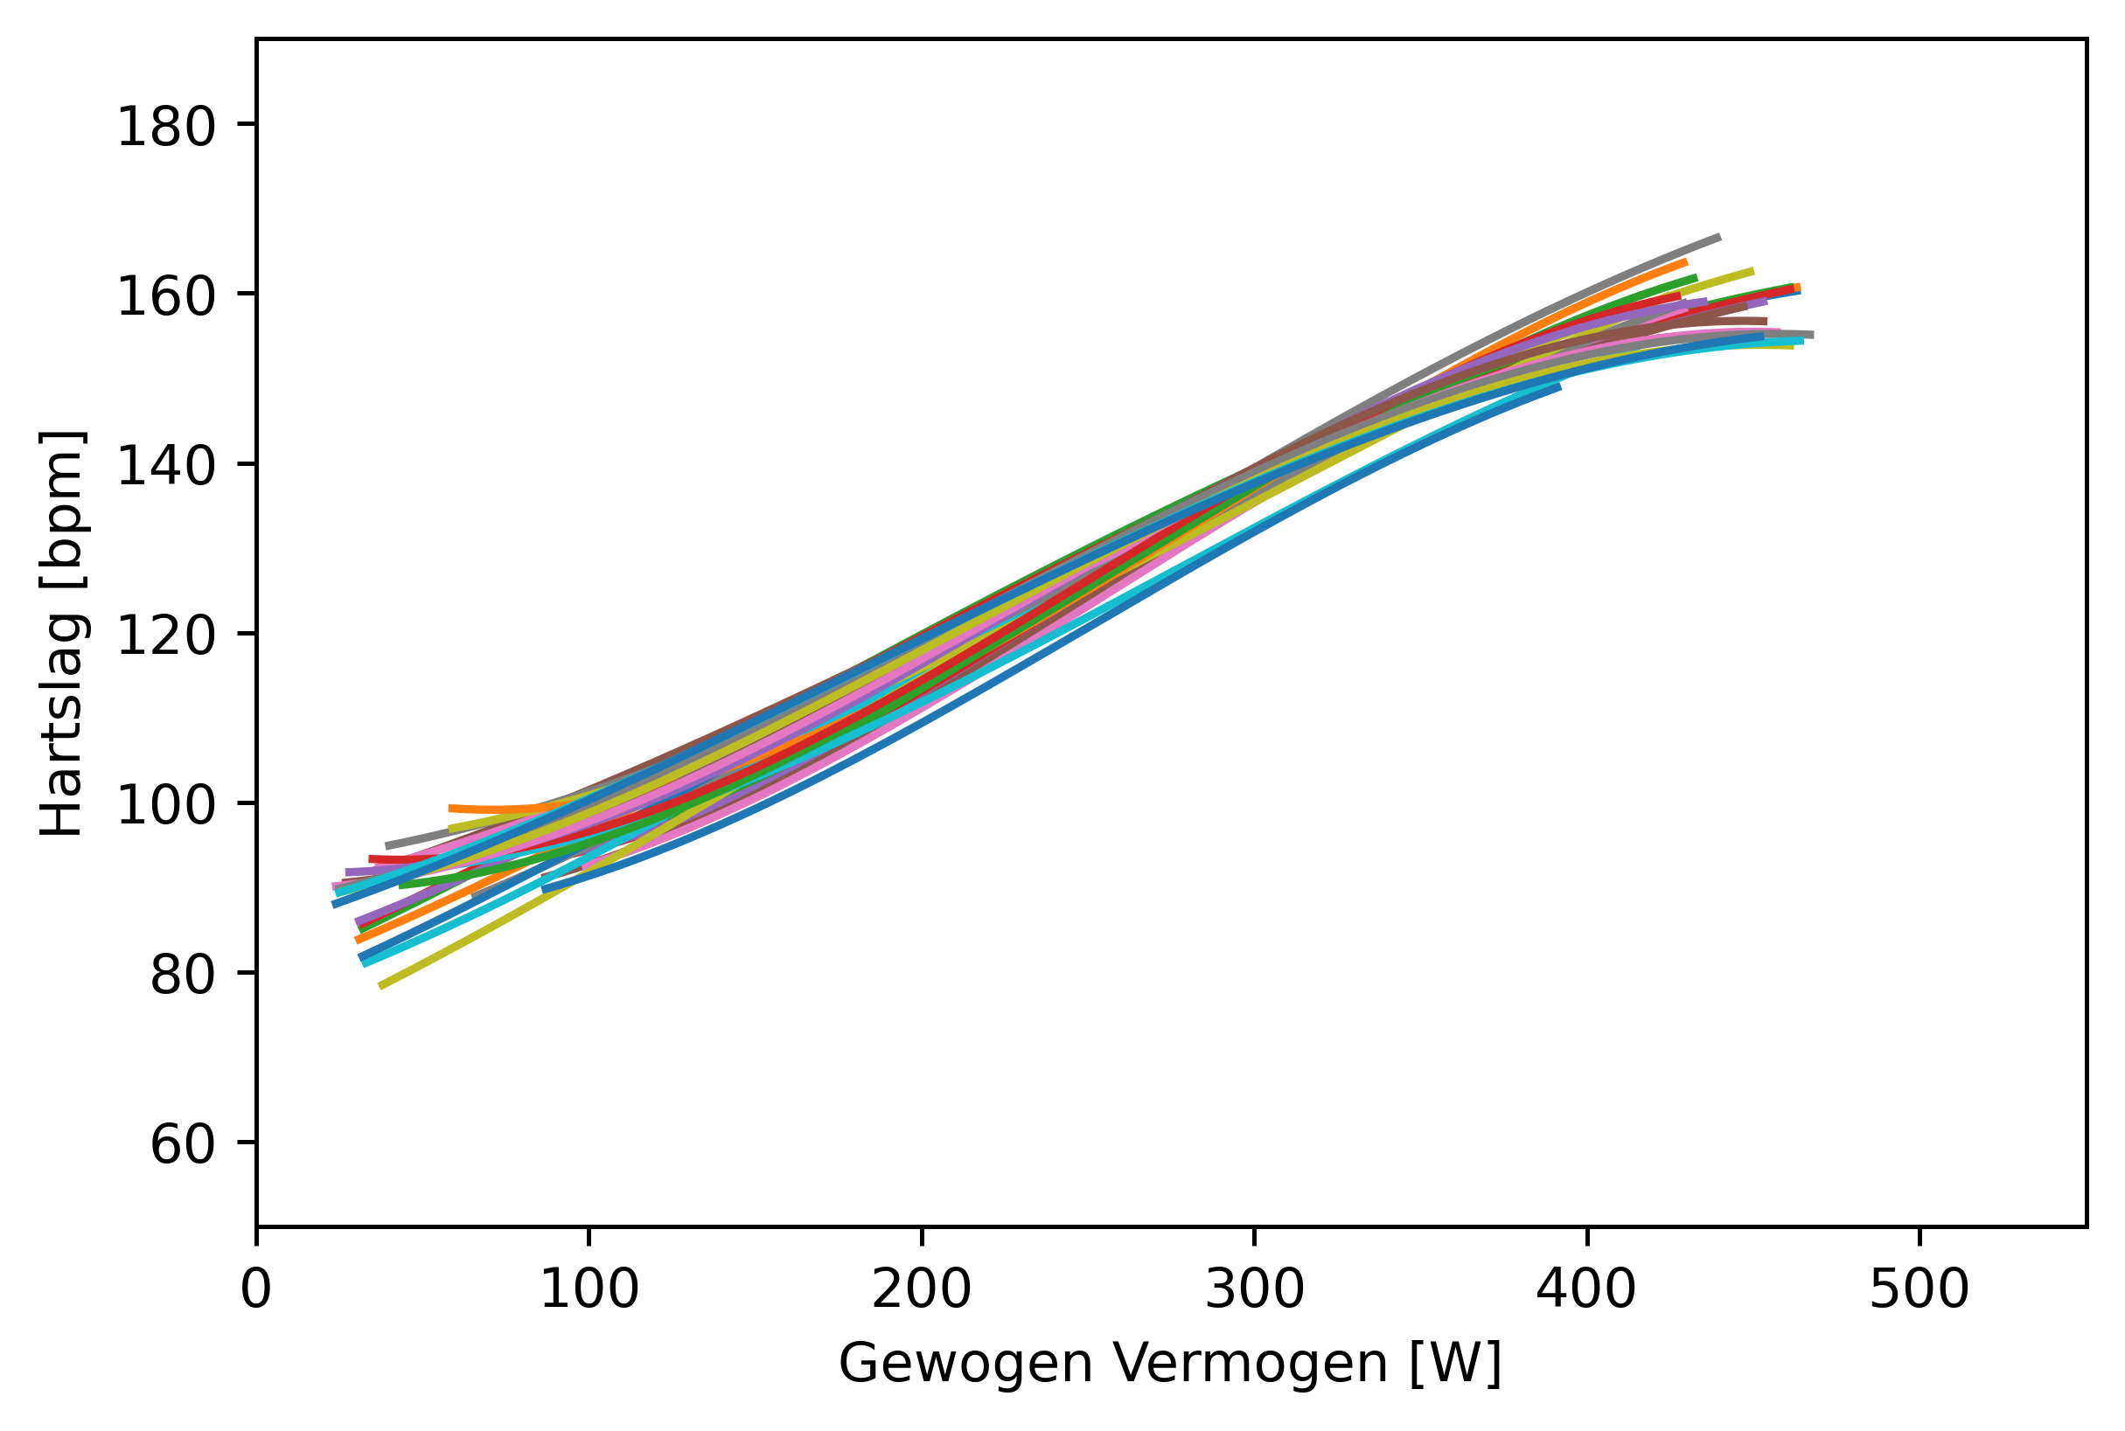
Heart Rate Performance Curve
Heart rate performance curves can be determined per day
March 2016

Slide 16
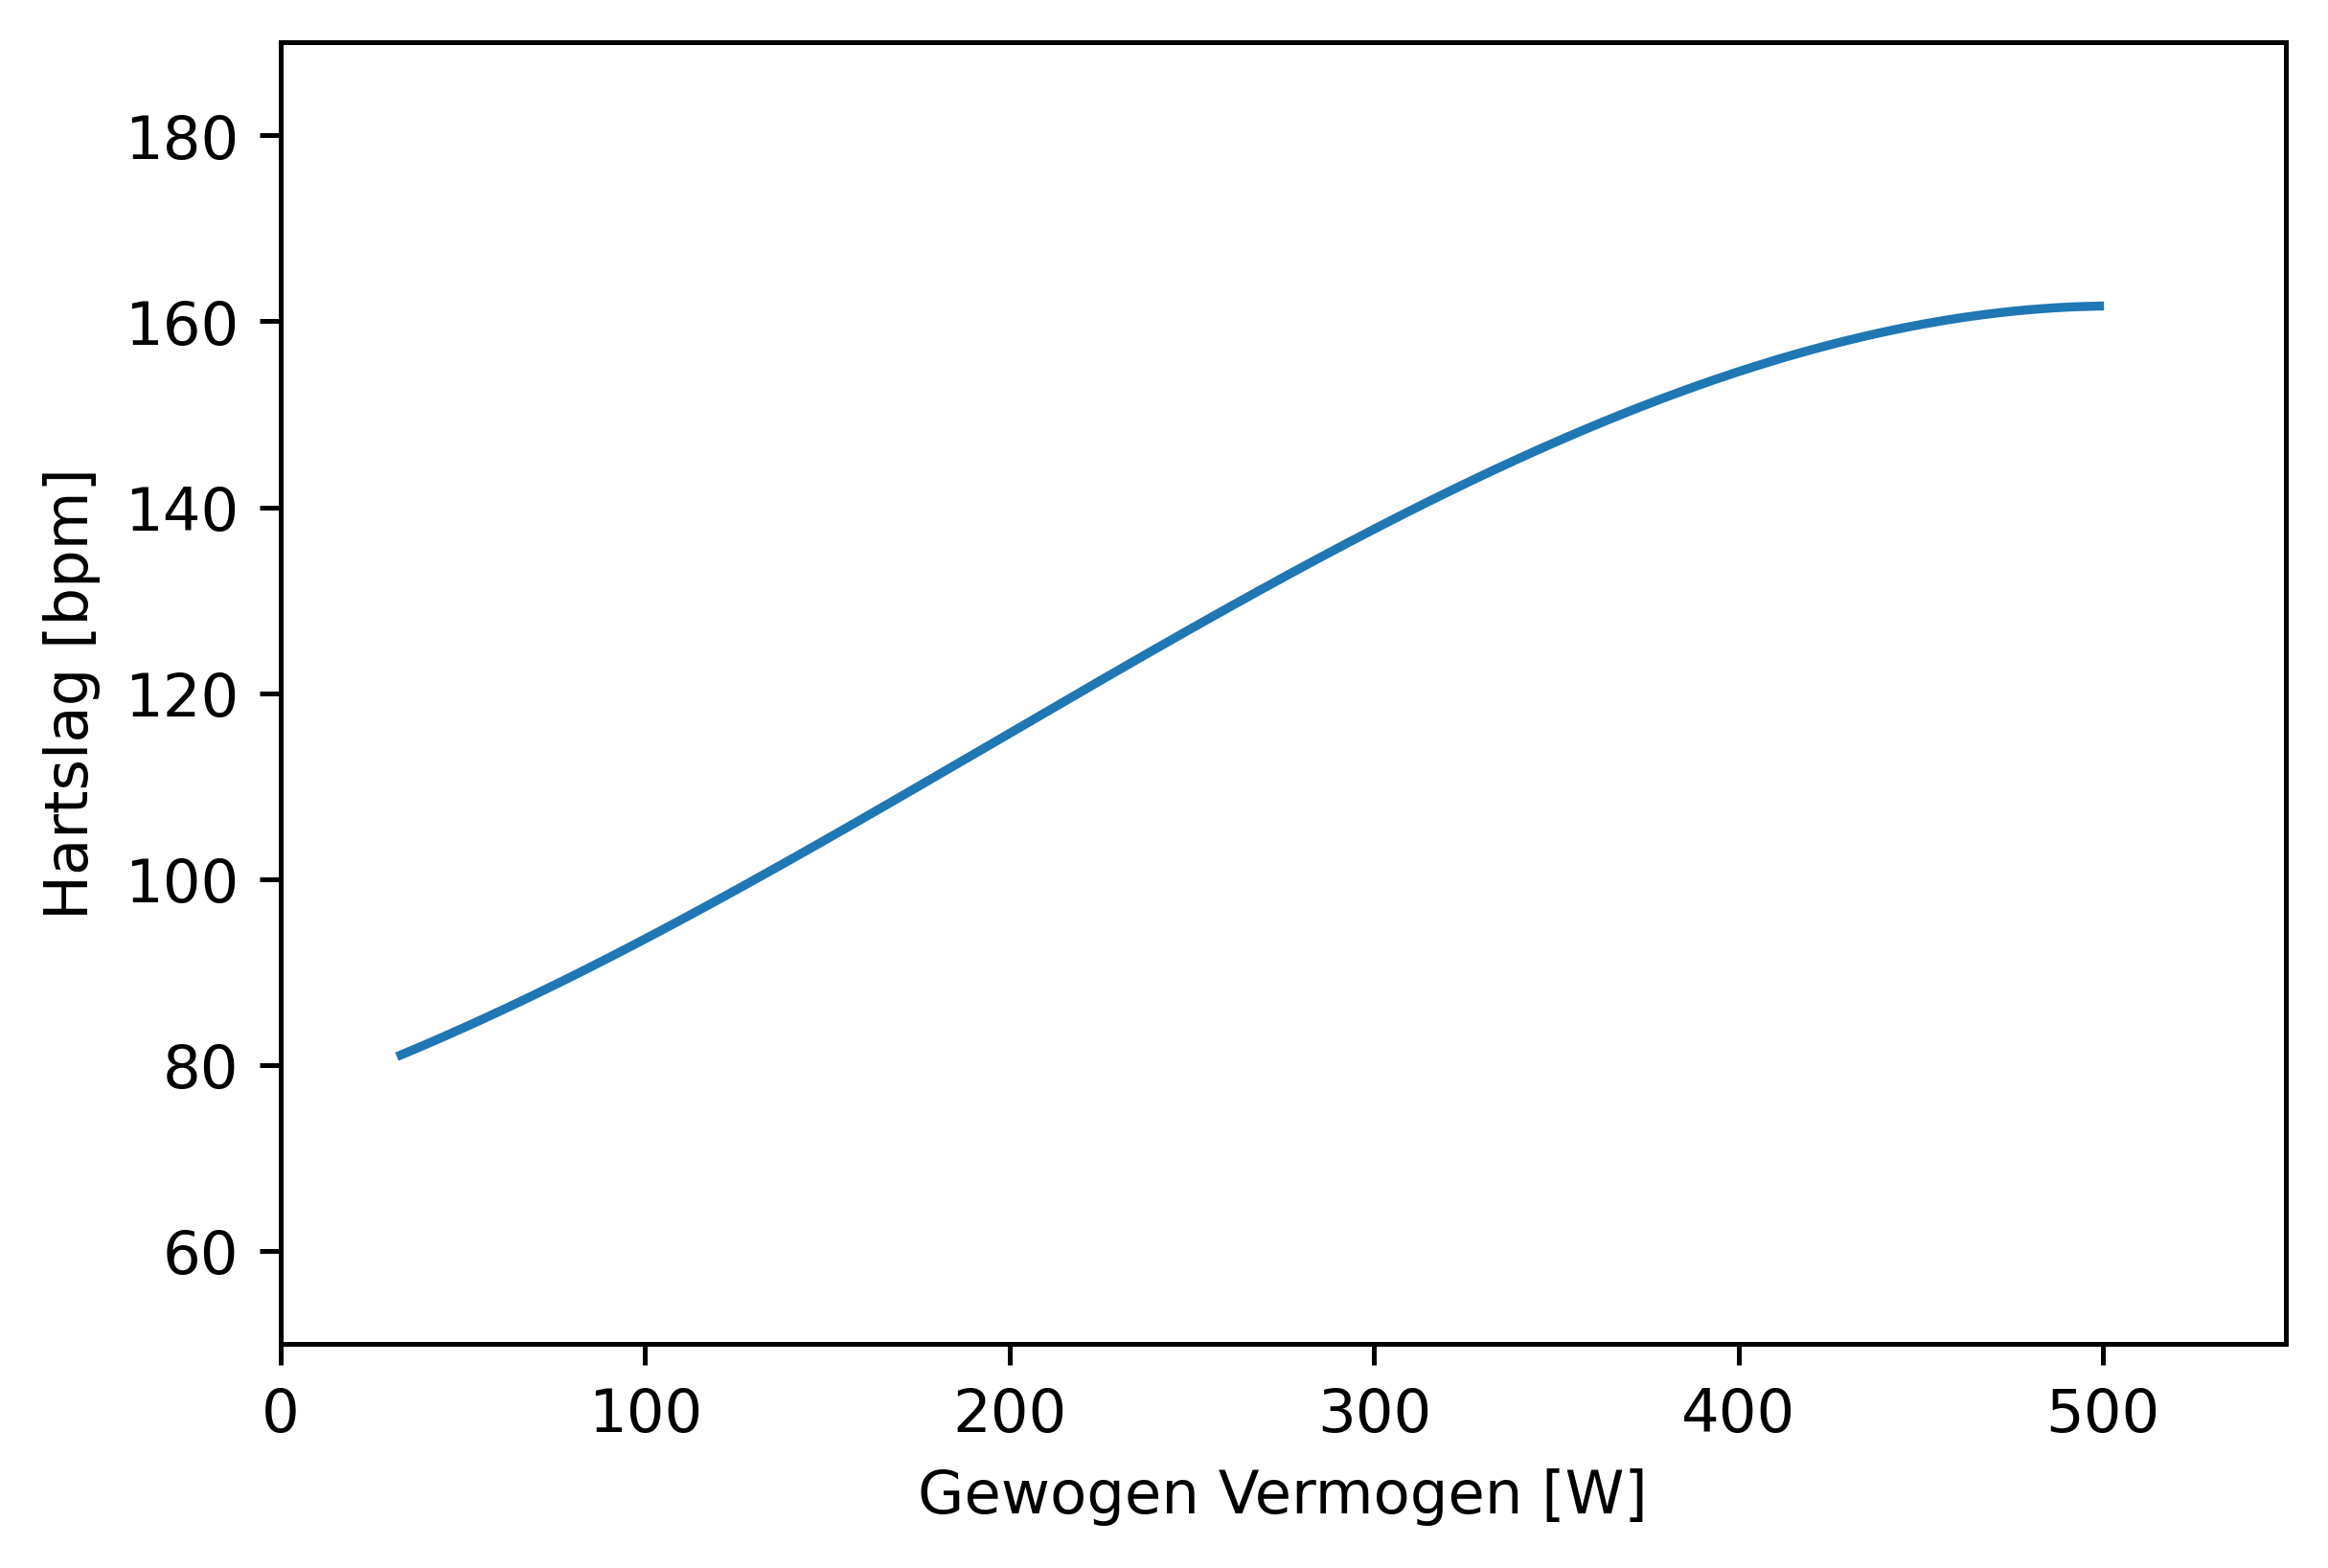
Determine Aerobic and Anaerobic Thresholds
H = 152 bpm
H = 122 bpm
FTP = 380 W
determined by specific test
(95% of 20 min sustained power)
P = 225 W
P = 381 W

Slide 17
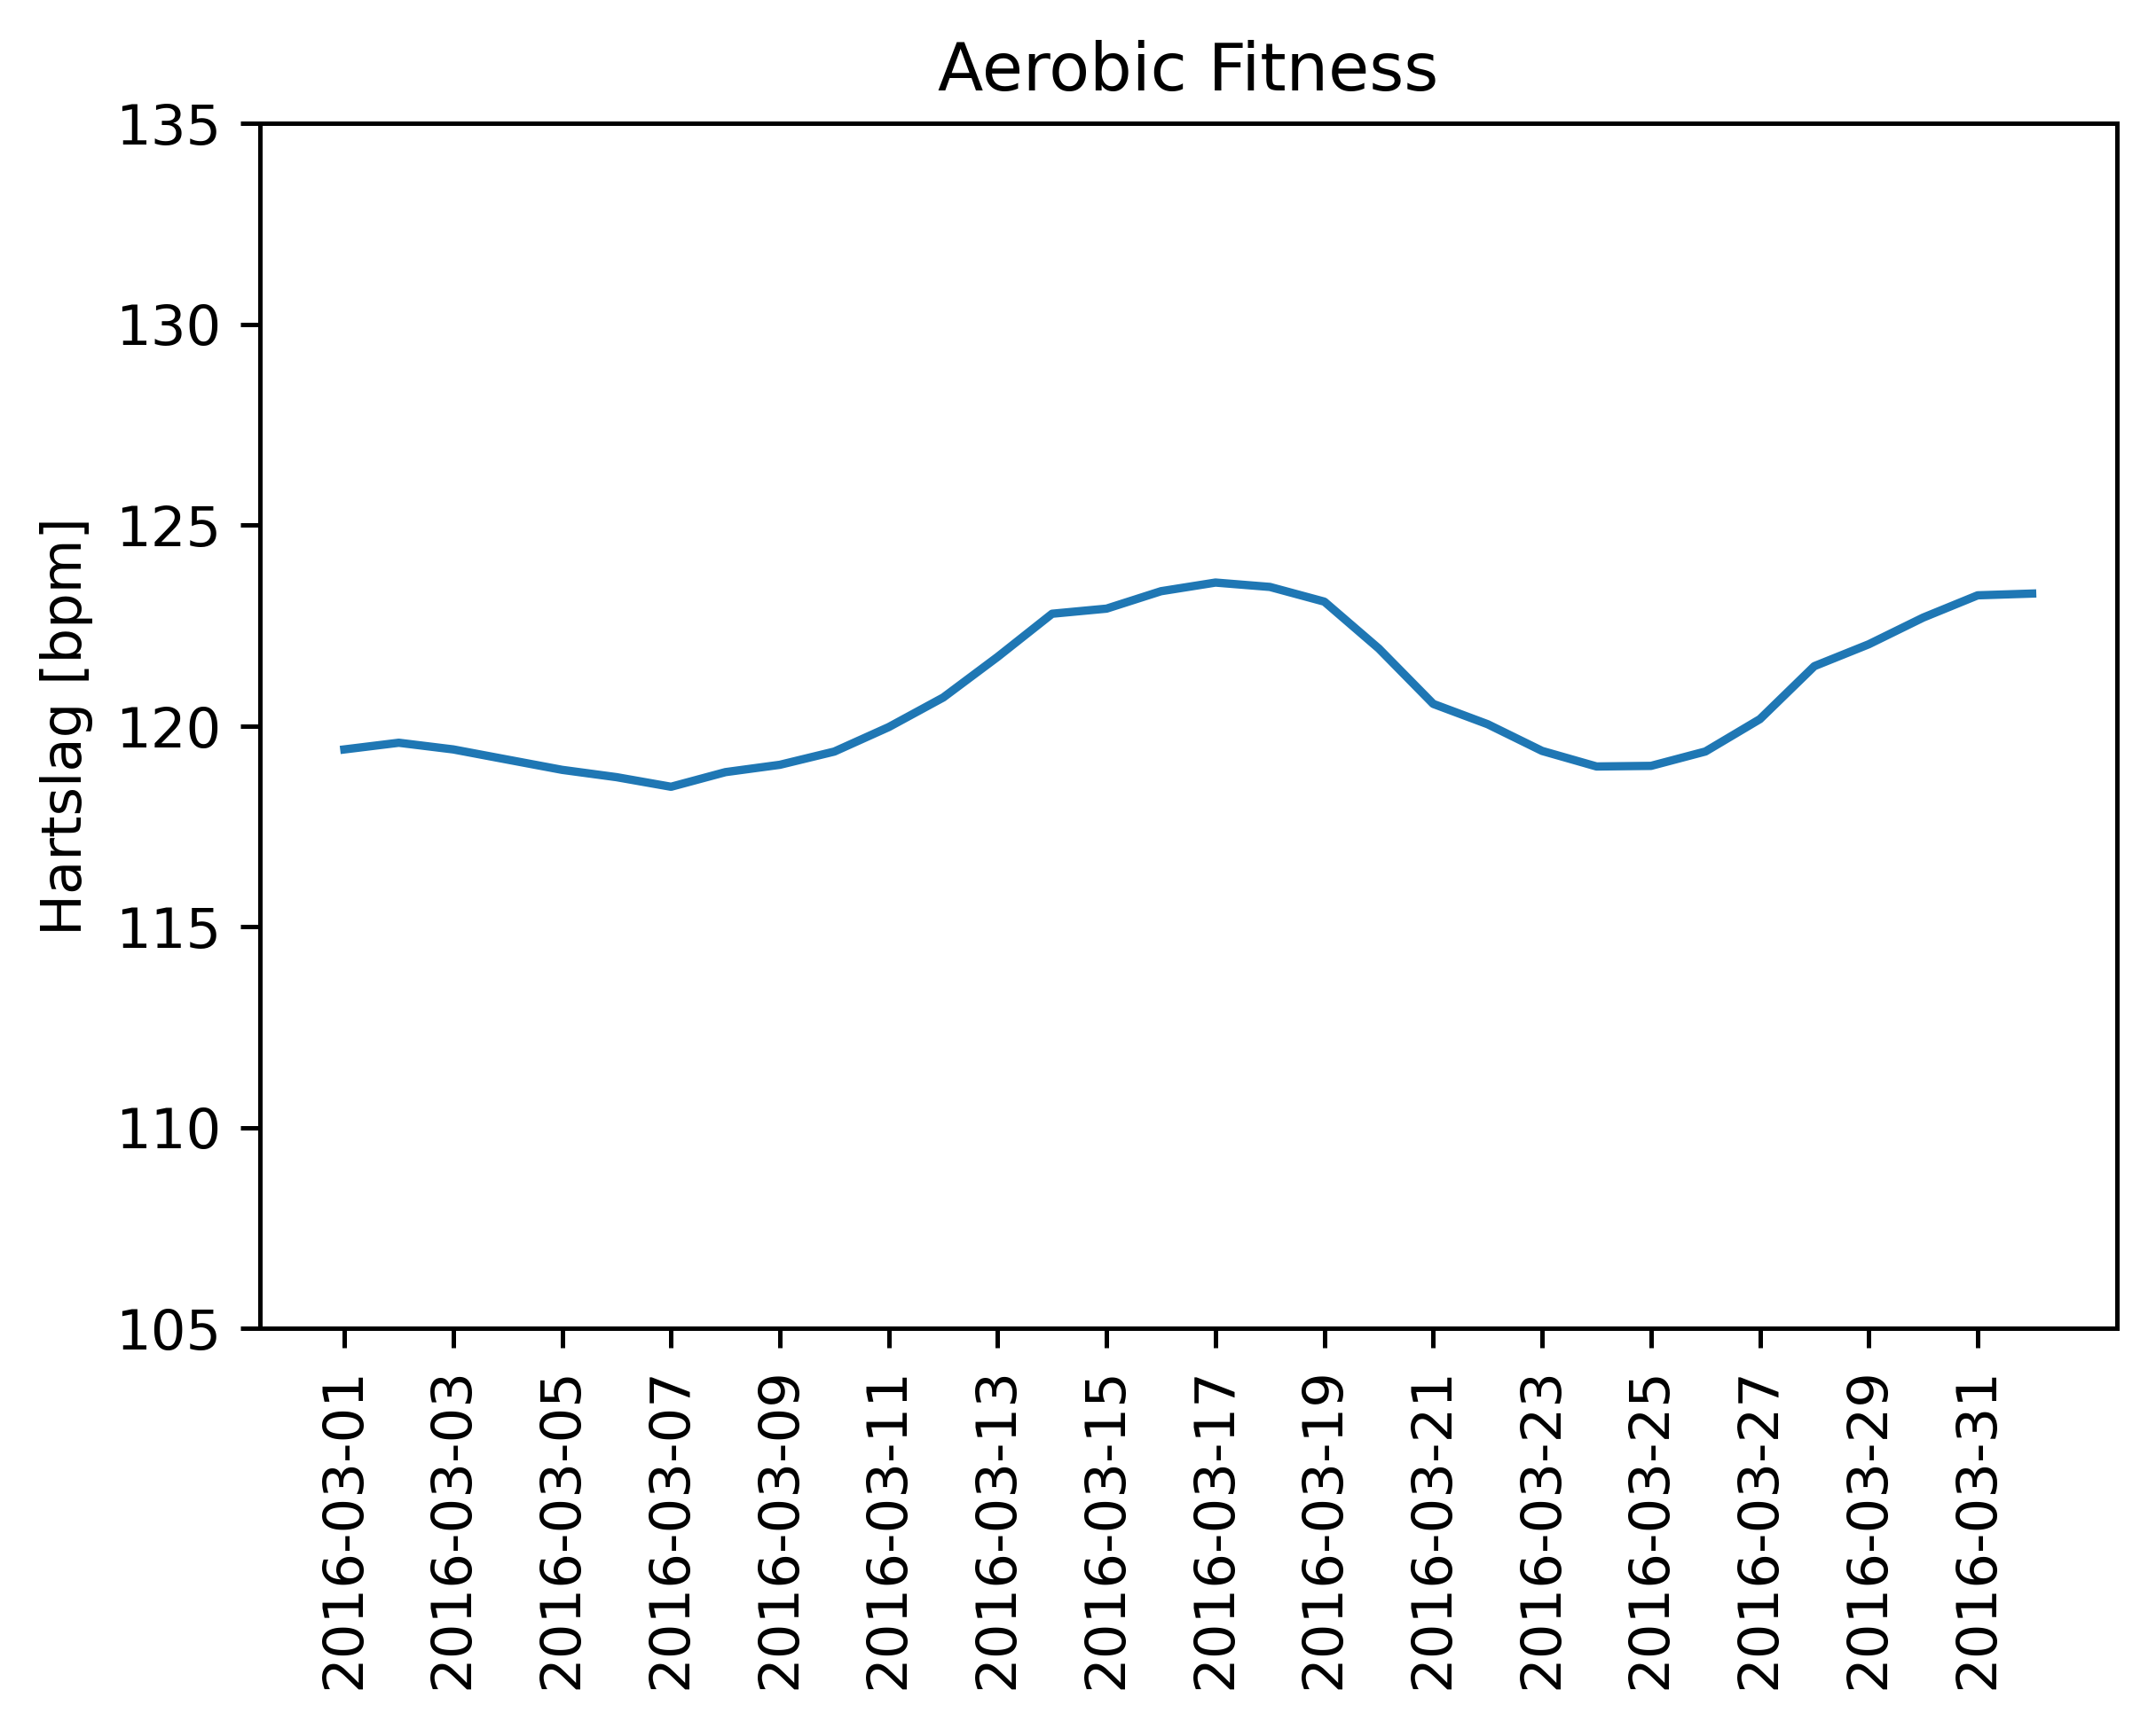
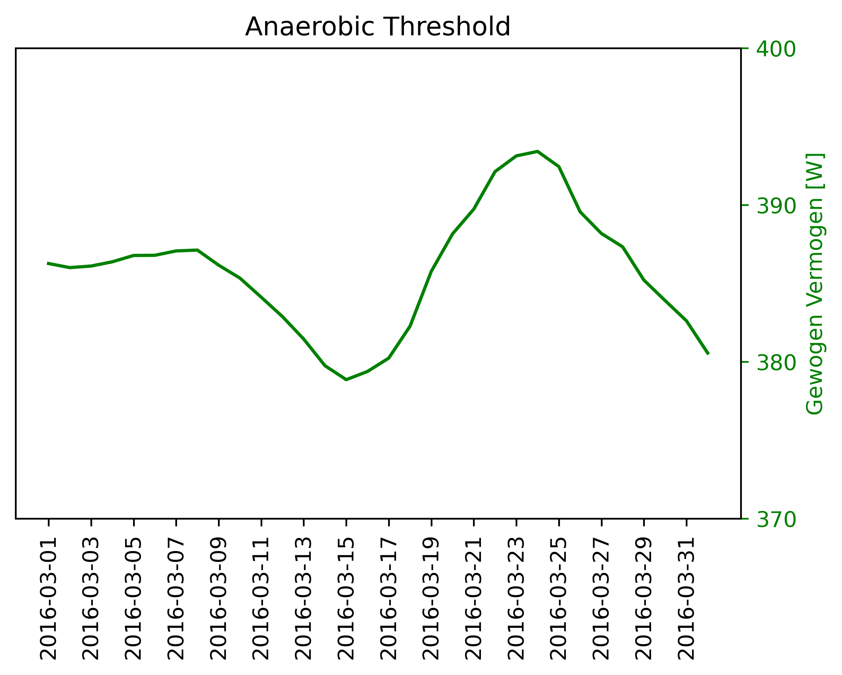
Tracking Thresholds over Time
FTP = 380 W

Slide 18
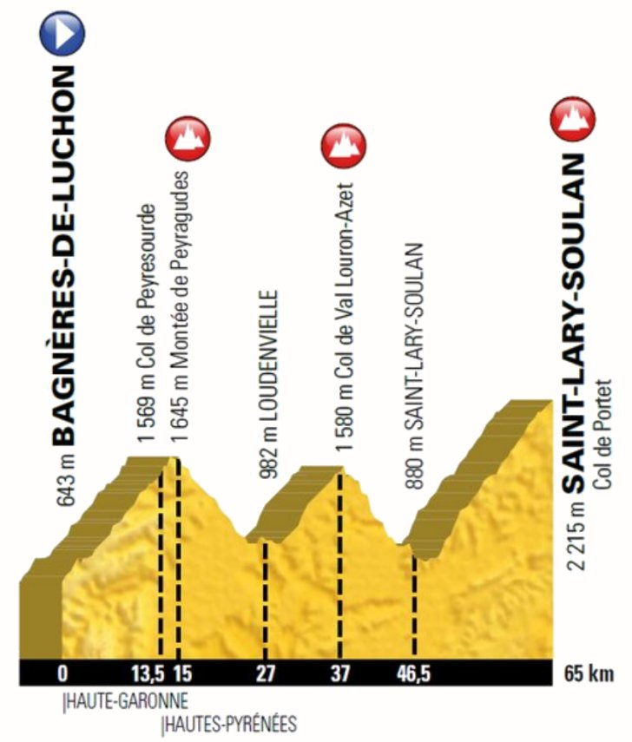
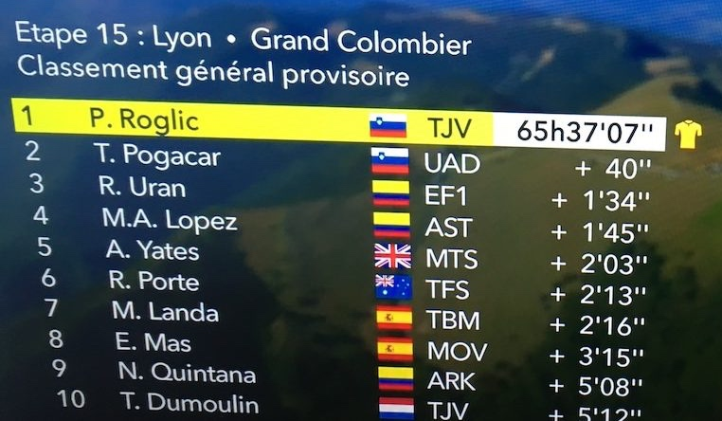
Relative Race Outcome Prediction
Time series regression in professional road cycling,
de Leeuw et al., Discovery Science 2020
Race Outcome for rider X
time lost/gained
race timing
stage suitability
tour suitability
…
…
…

Slide 19
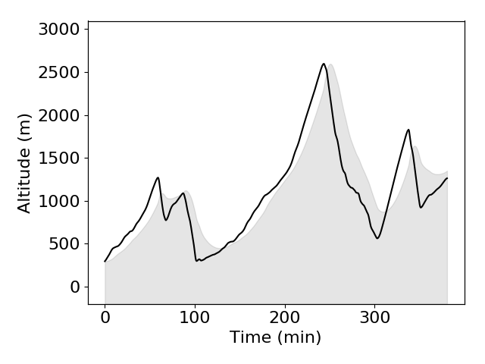
Cycling Analytics Pipeline
Lovere – Ponte di Legno
6:20:32 (35.6 km/h), 10.3 s quicker
Power/
Heart Rate
Model

Slide 20
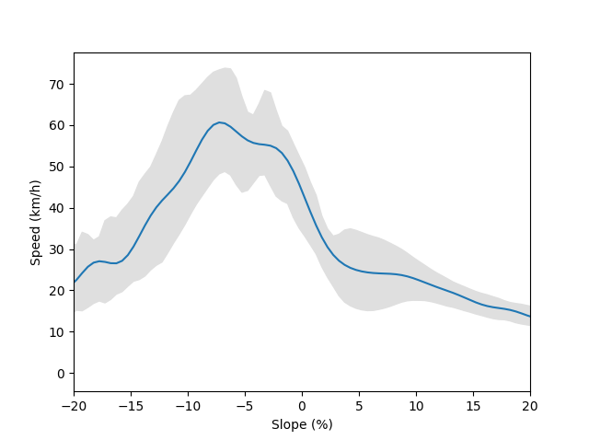
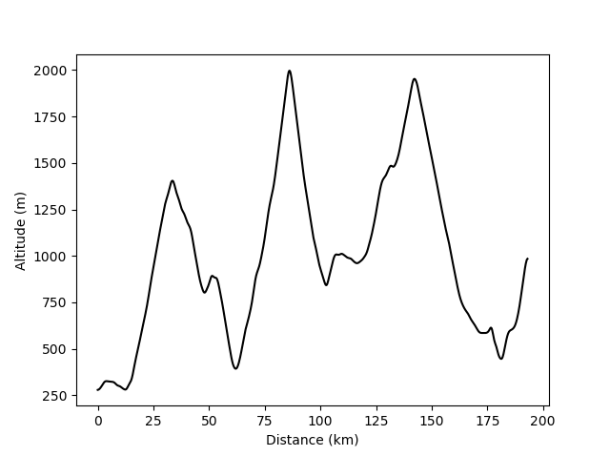
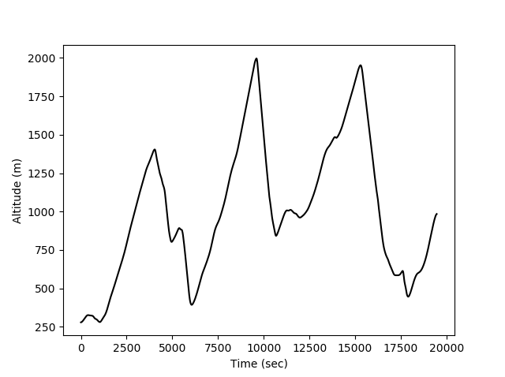
Climb-Descent Model
2 million data points
Lower speeds at larger descents (negative slopes)
Confidence intervals: avg. speed plus or minus stand. dev. speed
Distance Profile
Time Profile

Slide 21
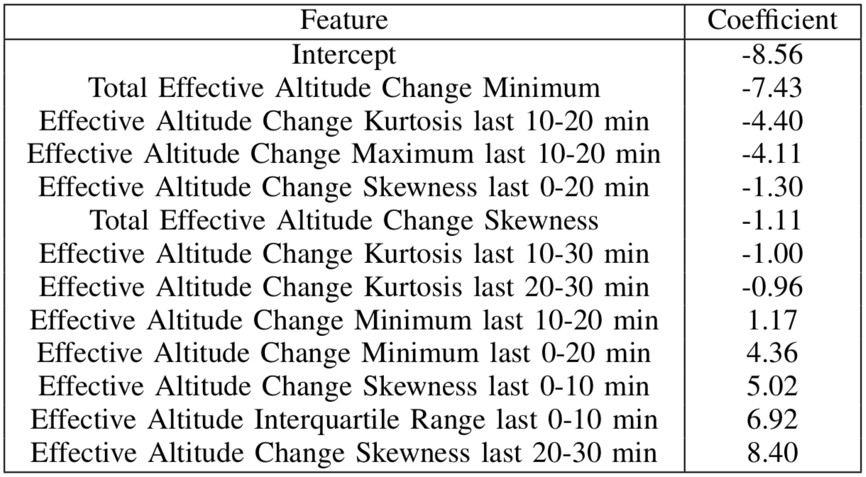
Prediction Model
Linear regression model based on constructed features
Derived features capture nature of the stage profile, specifically the last 0…30 minutes
10-20
20-30

Slide 22
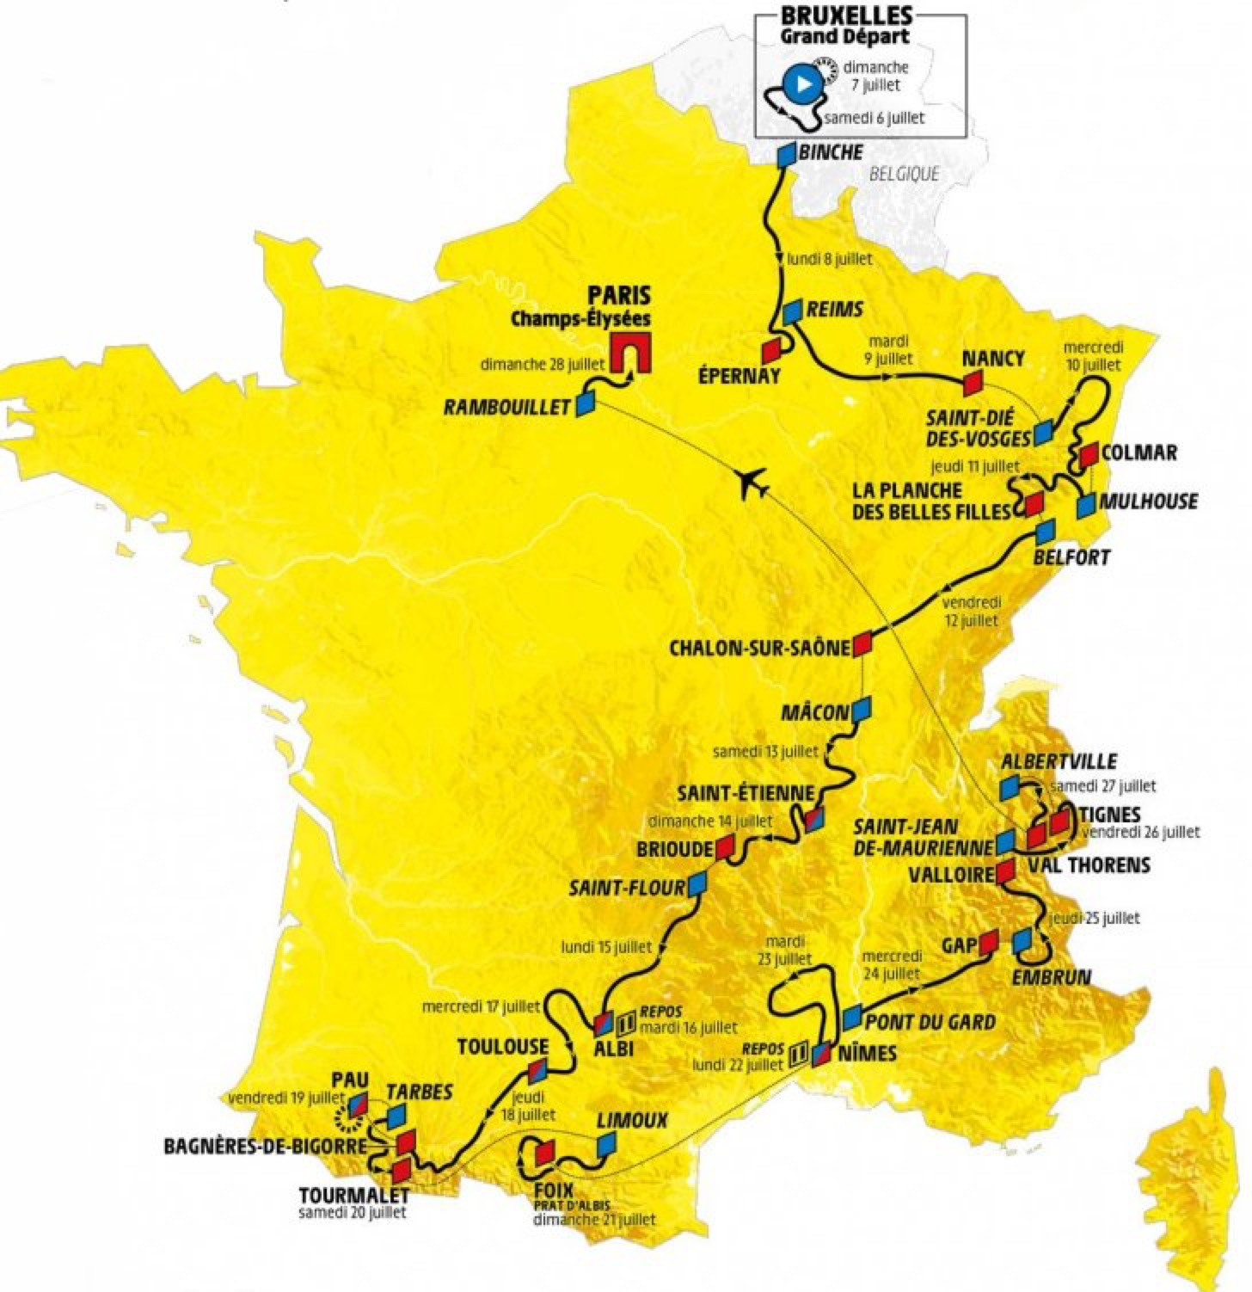
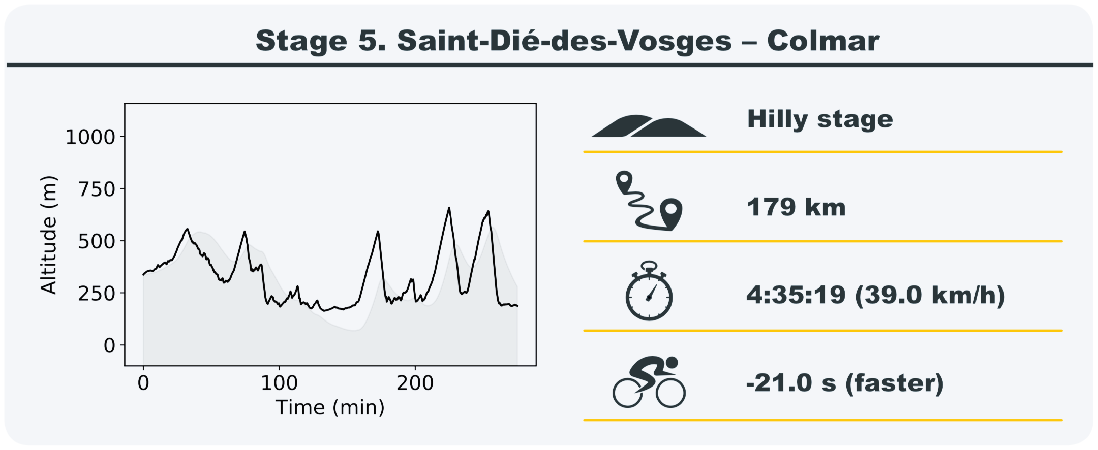
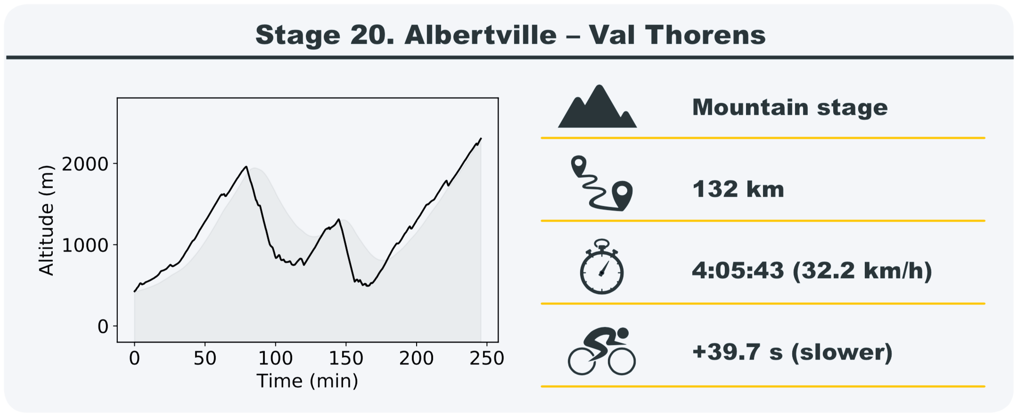
Tour de France ‘predictions’
0 s
stage shortened

Slide 23
Questions?

